Slide 1



CI PIPELINE PROJECT USING JENKINS AND GITHUB
PRESENTED BY:
BHAWANA GUPTA
PRESENTED TO:
Mr. ASHISH AGRAWAL

Slide 2
What is CI?
CI or Continuous Integration is the practice of automating the integration of code changes from multiple developers into a single codebase. It is a software development practice where the developers commit their work frequently into the central code repository (Github or Stash). Then there are automated tools that build the newly committed code and do a code review, etc as required upon integration.
The key goals of Continuous Integration are to find and address bugs quicker, make the process of integrating code across a team of developers easier, improve software quality and reduce the time it takes to release new feature updates. Some popular CI tools are Jenkins, TeamCity, and Bamboo.

Slide 3
What’s a CI/CD pipeline?
A pipeline is a process that drives software development through a path of building, testing, and deploying code, also known as CI/CD. By automating the process, the objective is to minimize human error and maintain a consistent process for how software is released. Tools that are included in the pipeline could include compiling code, unit tests, code analysis, security, and binaries creation. For containerized environments, this pipeline would also include packaging the code into a container image to be deployed across a hybrid cloud.
CI/CD is the backbone of a DevOps methodology, bringing developers and IT operations teams together to deploy software. As custom applications become key to how companies differentiate, the rate at which code can be released has become a competitive differentiator.

Slide 4
How CI Works?
Once the developer commits their code to a version control system like Git, it triggers the CI pipeline which fetches the changes and runs automated build and unit tests. Based on the status of the step, the server then notifies the concerned developer whether the integration of the new code to the existing code base was a success or a failure.
This helps in finding and addressing the bugs much quickly, makes the team more productive by freeing the developers from manual tasks, and helps teams deliver updates to their customers more frequently. It has been found that integrating the entire development cycle can reduce the developer’s time involved by ~25 – 30%.

Slide 5
In the SDLC, CI mainly covers the source and Build phases. A CI pipeline typically involves these steps:
Detect changes in the code
Analyze the quality of the source code
Build
Execute all unit tests
Execute all integration tests
Generate deployable artifacts
Report status
If any of the above steps fail, the integration stops immediately, and the team is notified about the result.

Slide 6
STEPS
To configure CI pipeline with Jenkins, the first step is to install Jenkins. And for that steps are as follows:
Launch an instance of Redhat with instance type t2.small\t3.small. And also allow port 8080 in the security group while launching.
Login into the machine using SSH on Command Prompt. Now execute the following Commands to Install Jenkins:
Sudo –i
Yum install wget –y
sudo wget –o / etc / yum . repos . d / jenkins . repo \ https : // pkg .Jenkins .io / redhat -stable / jenkins .repo

Slide 7
sudo rpm --import https : //pkg . jenkins . io / redhat – stable / Jenkins .io – 2023 . Key
sudo yum upgrade
sudo yum install java-17-openjdk
sudo yum install Jenkins
sudo systemctl daemon-reload
Screenshots of the executed commands are as follows . And for reference you can also visit https://www.Jenkins.io/doc/book/installing/linux/#red-hat-centos.

Slide 8
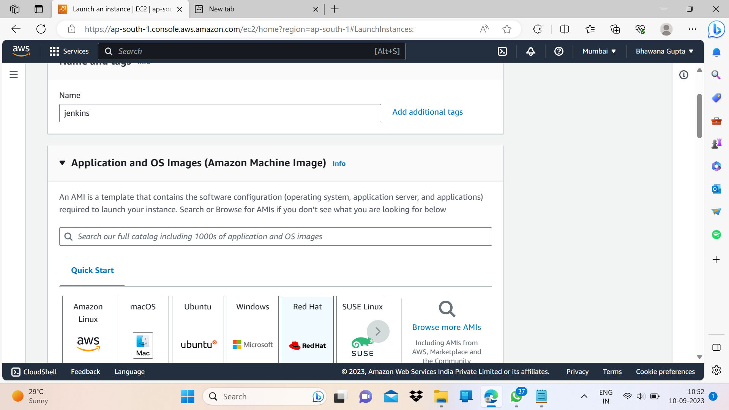


Slide 9
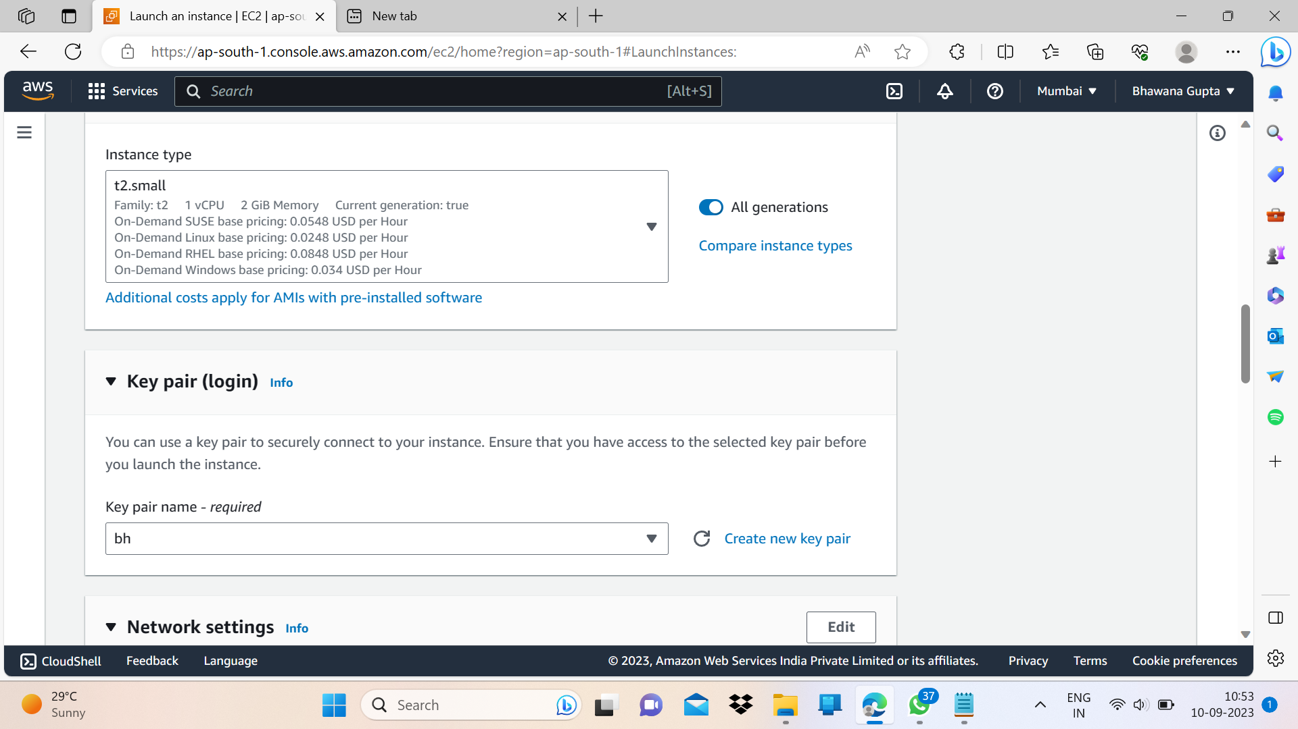


Slide 10
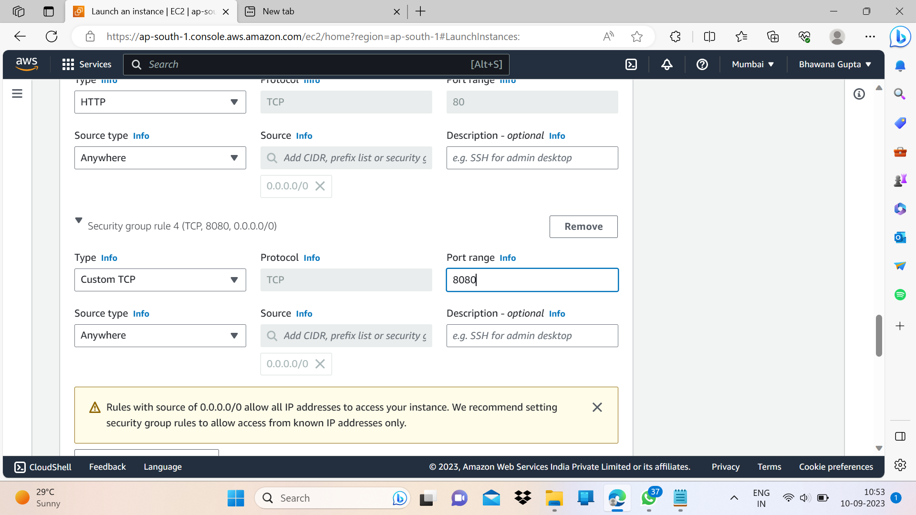


Slide 11
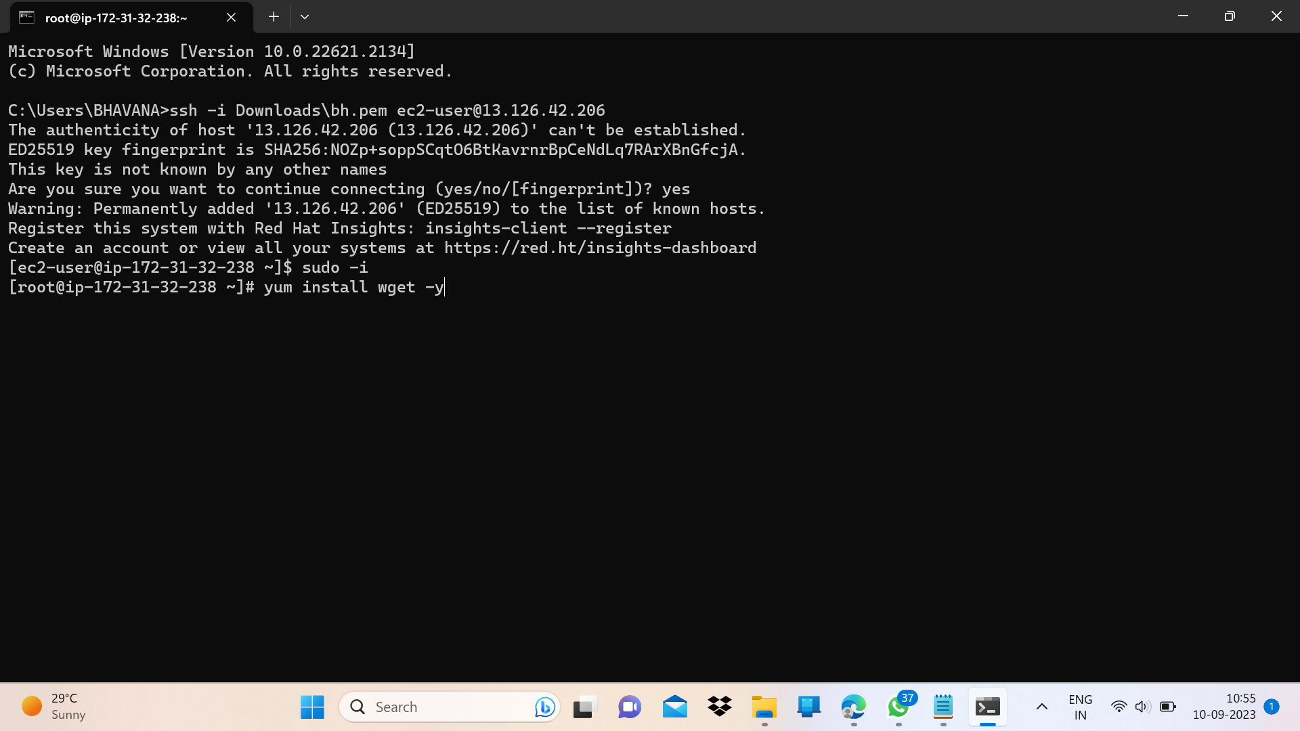

Slide 12
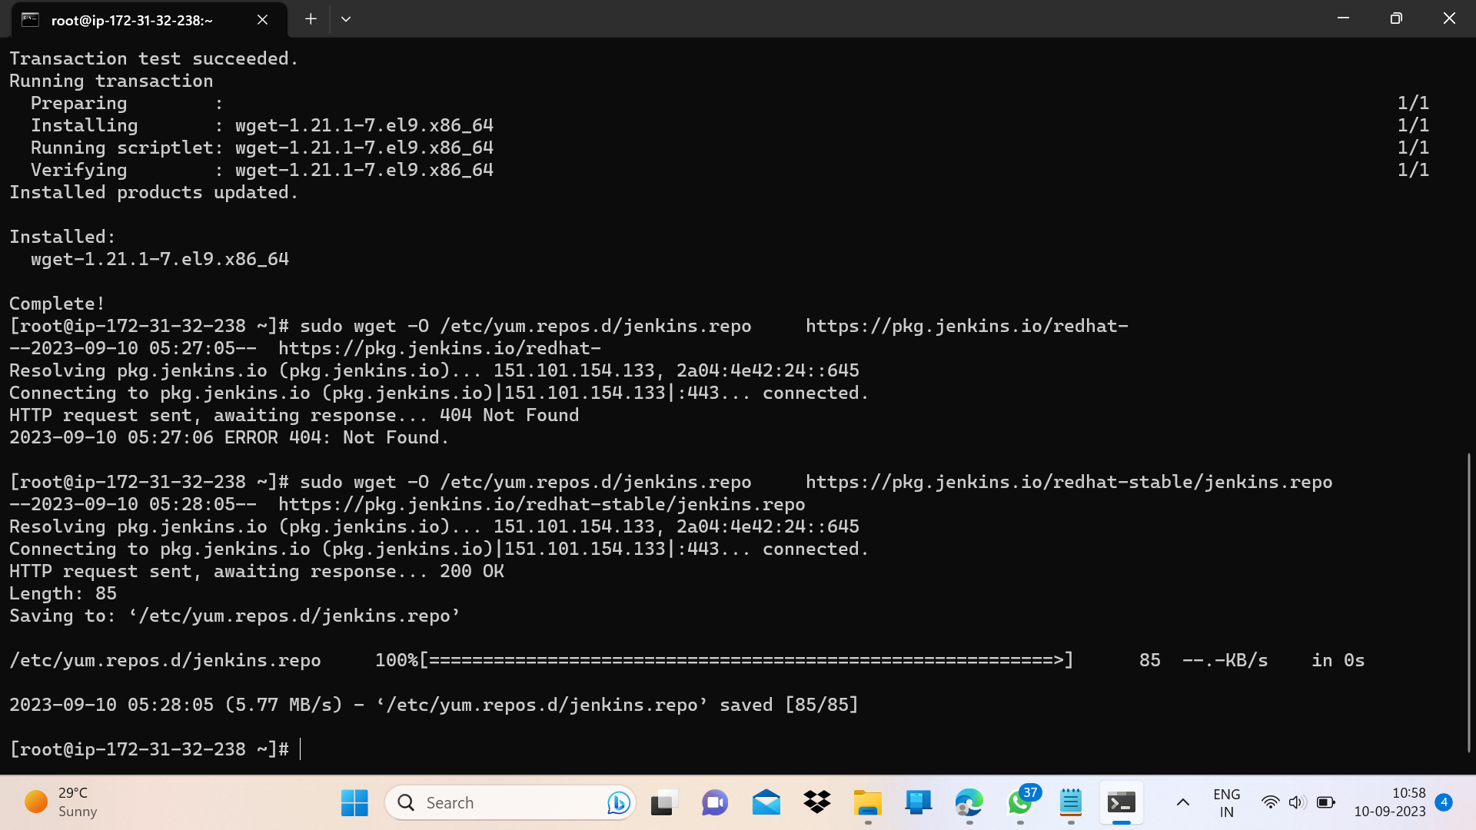

Slide 13
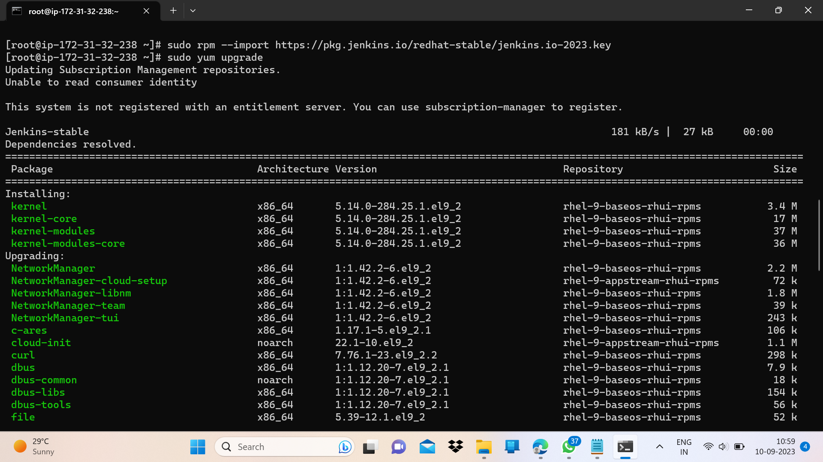

Slide 14
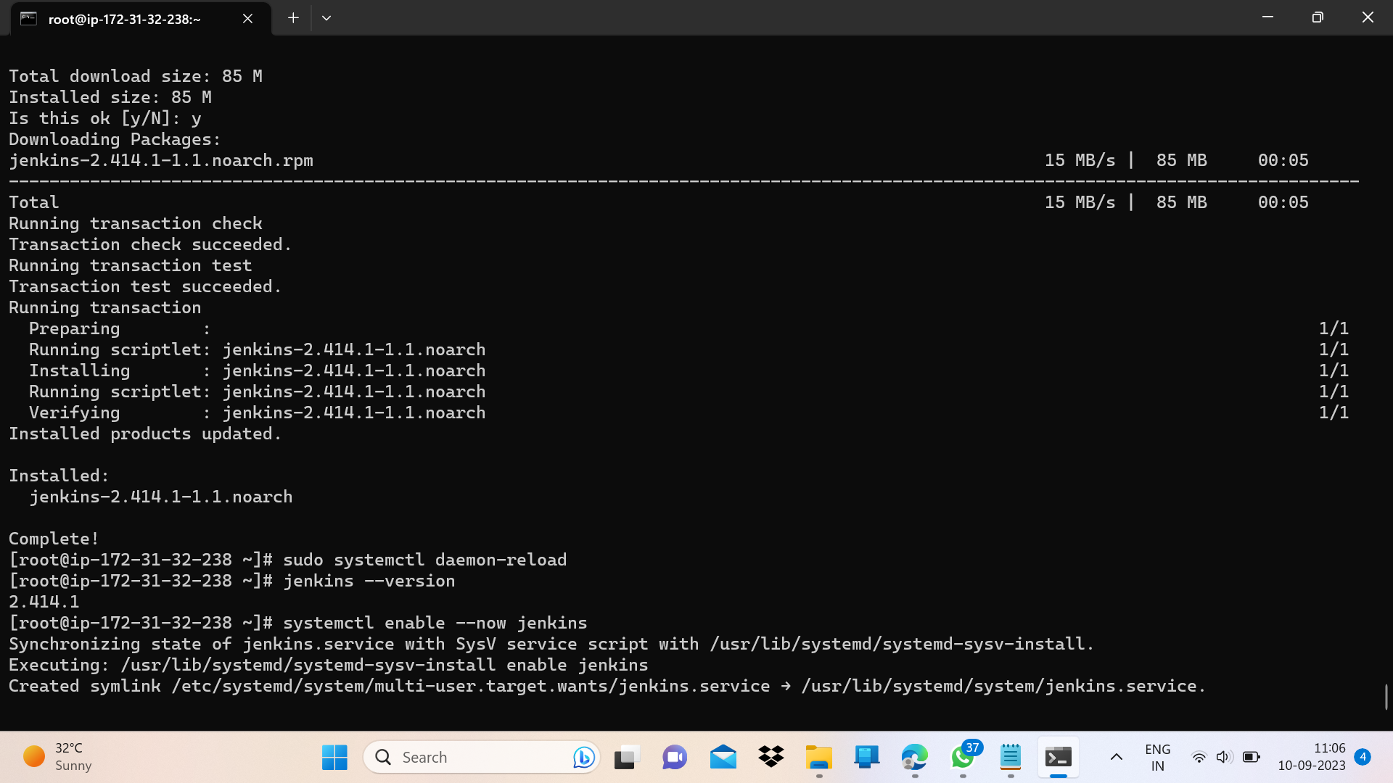
To check the installed Jenkins version :
Jenkins --version
Now enable the Jenkins service using following command:
Systemctl enable --now Jenkins
Now paste the “publicIP:8080” on browser to see Jenkins login page.

Slide 15
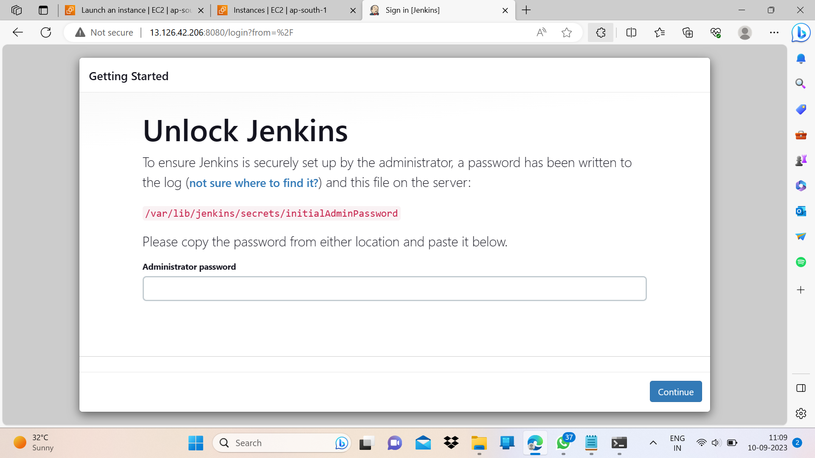
To unlock this, open the following file in terminal and paste the password here:
cat /var/lib/Jenkins/secrets/initialAdminPassword

Slide 16
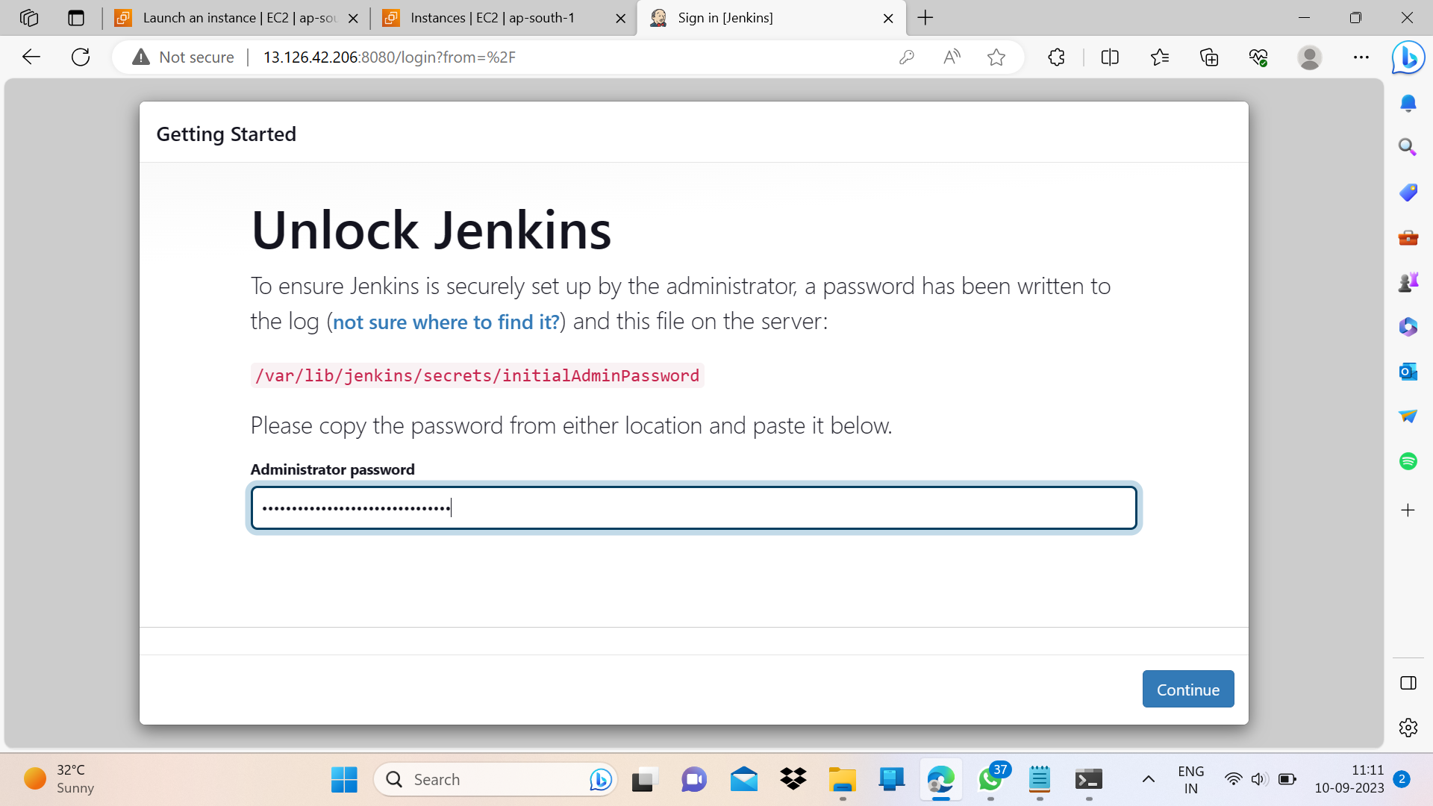
Copy this password and paste this in Jenkins server page.

Slide 17
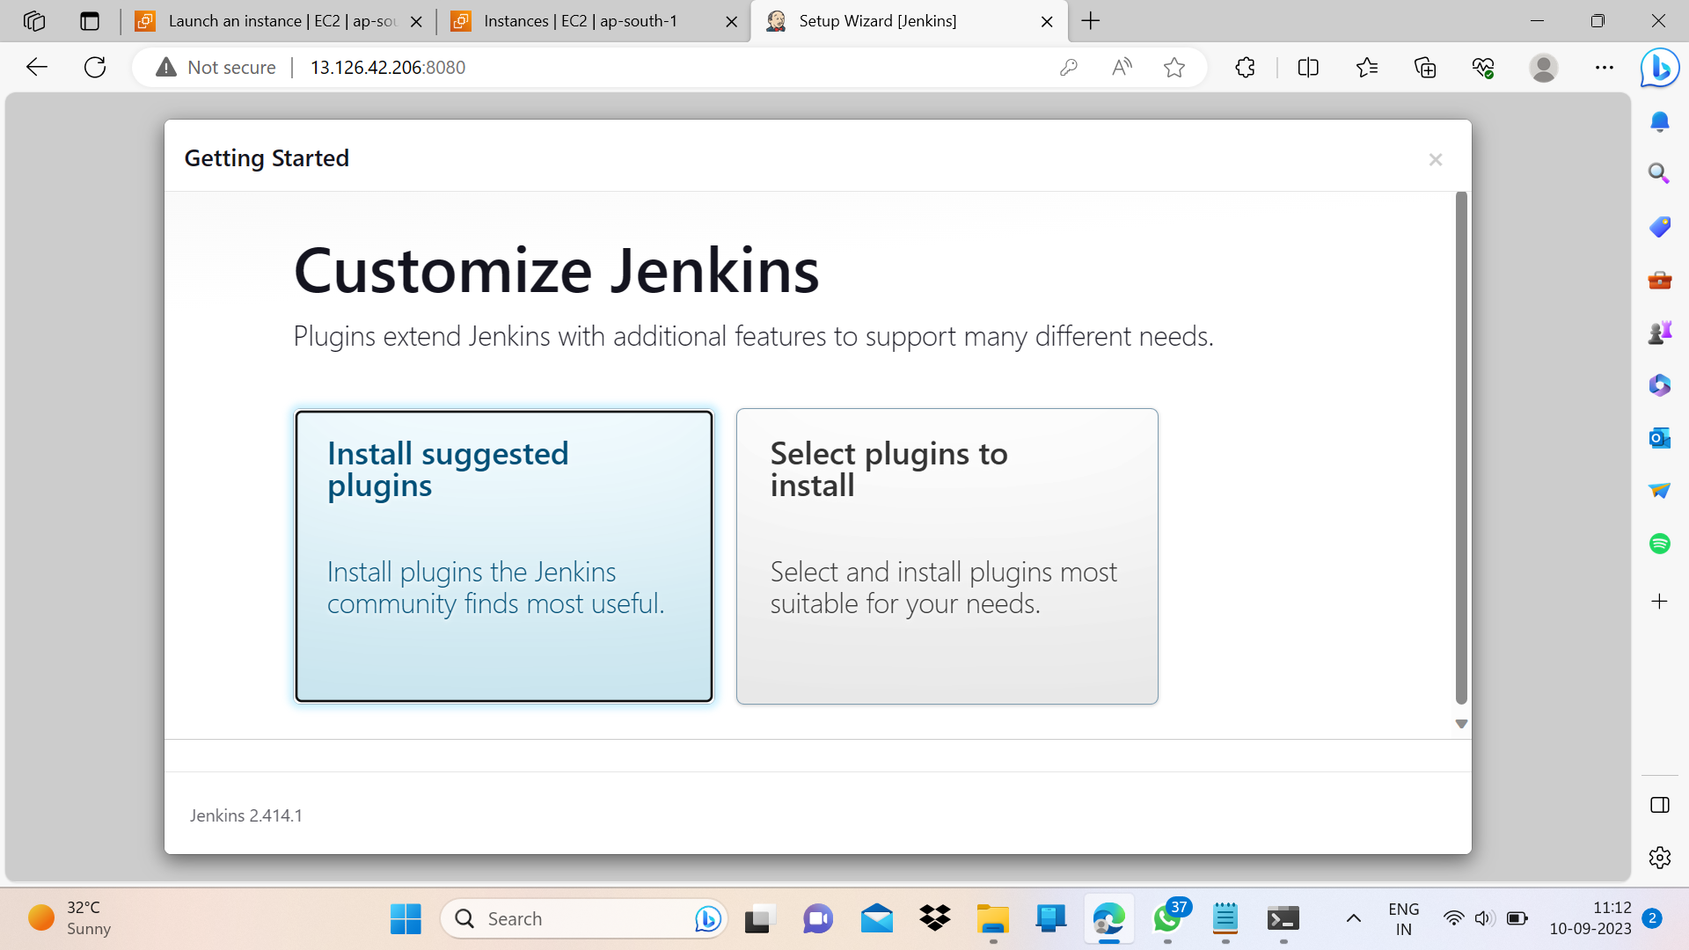
Click on install suggested plugins.

Slide 18
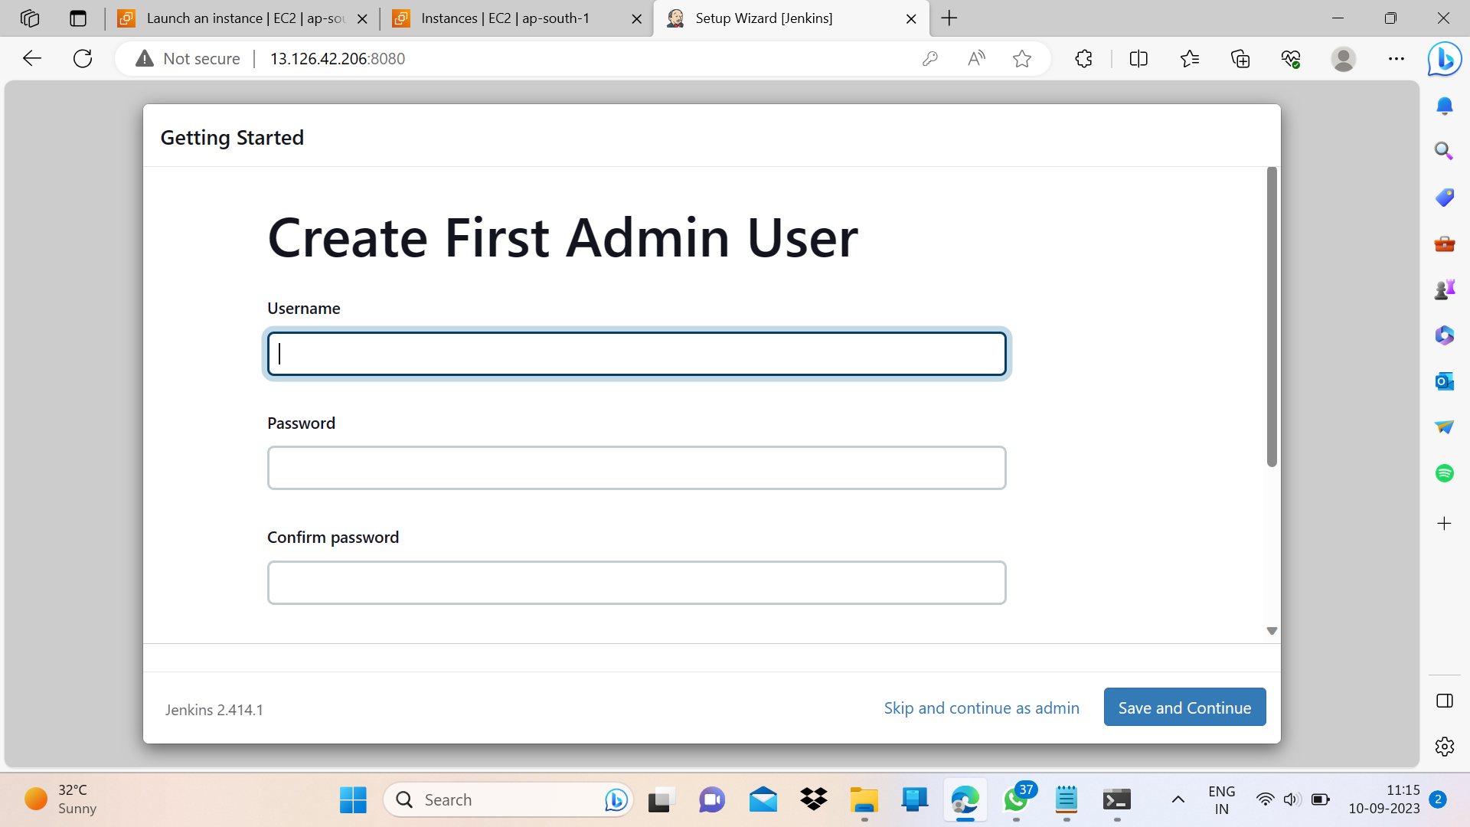

Click on skip and continue as admin.

Slide 19
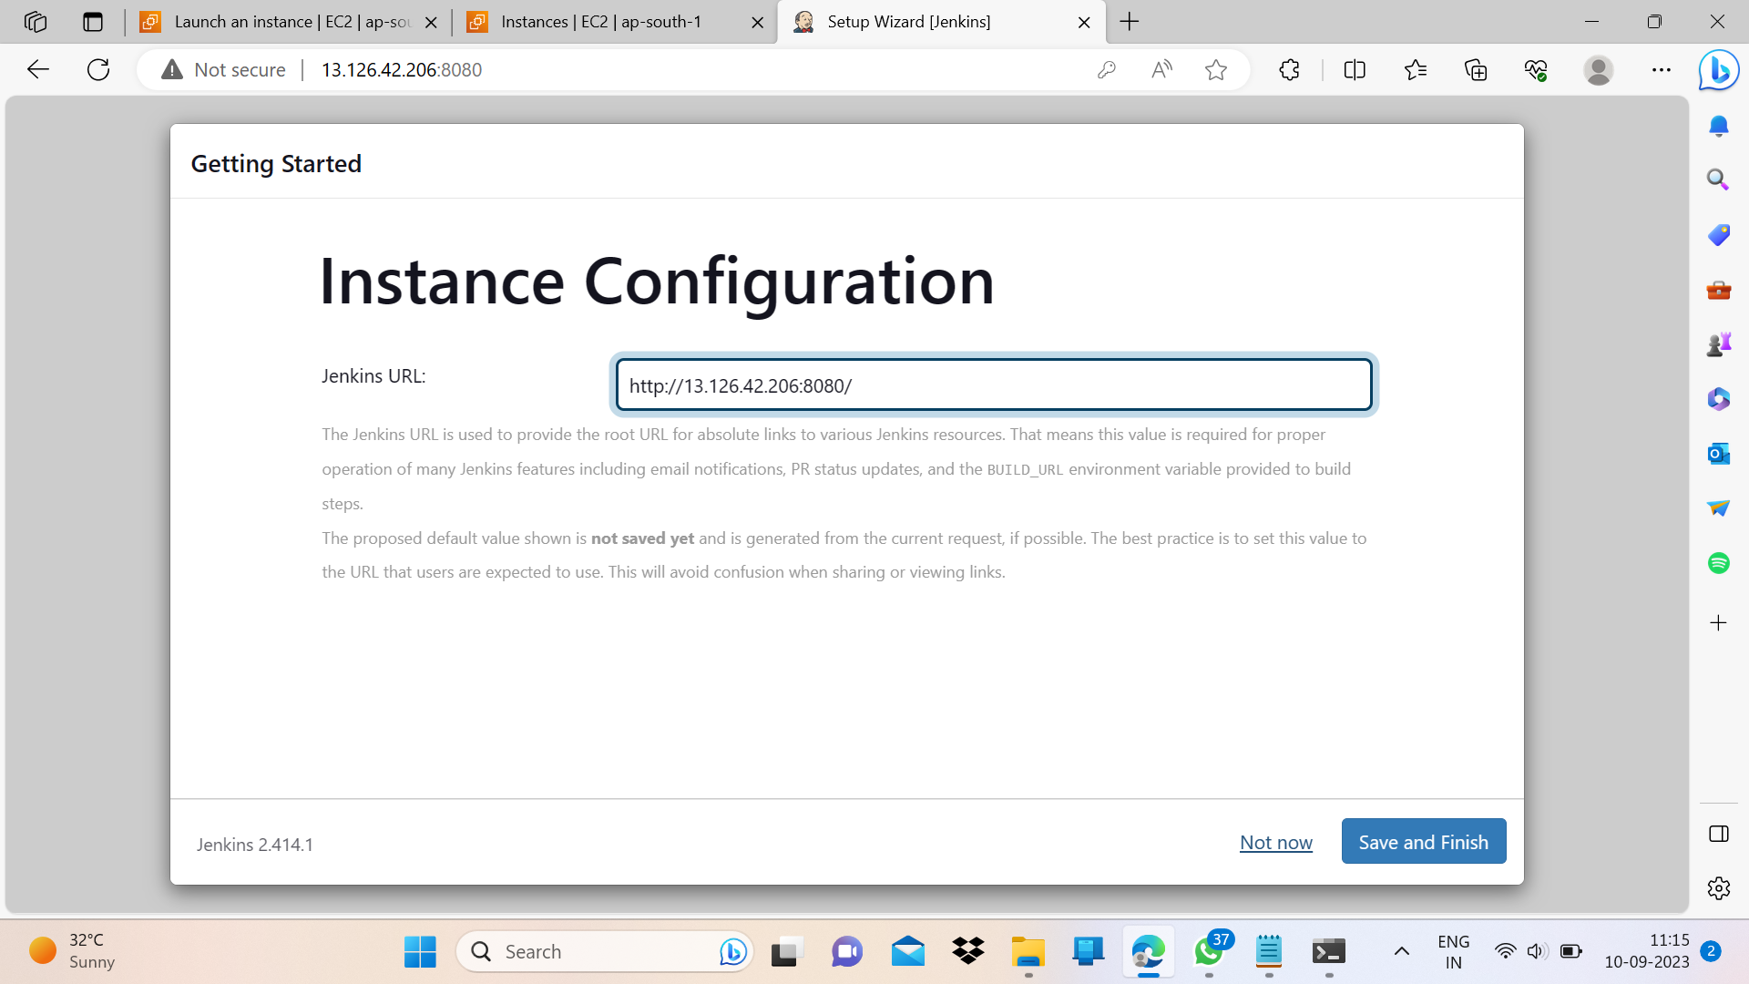

Click on save and finish.

Slide 20
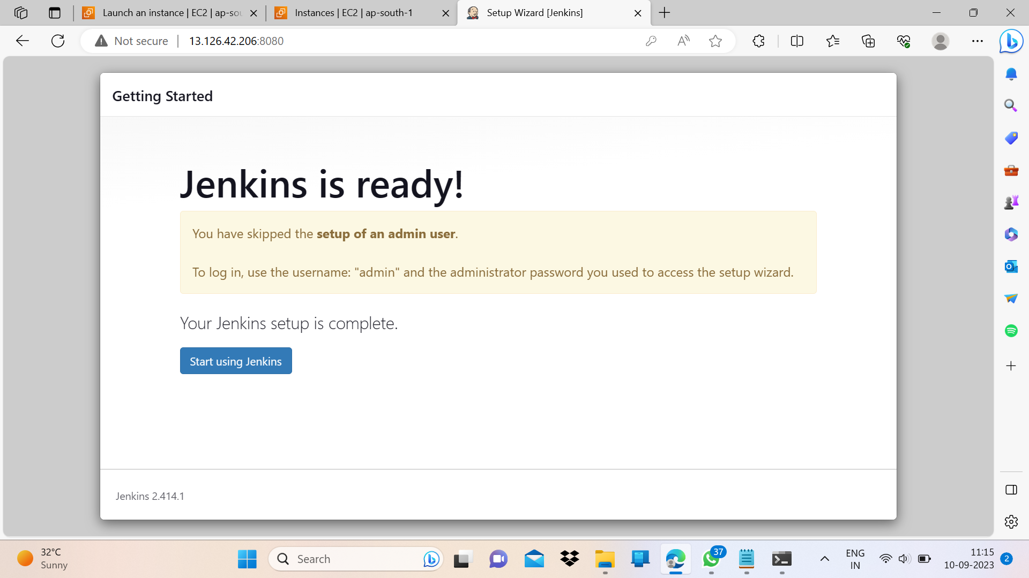

Click on Start using Jenkins.

Slide 21
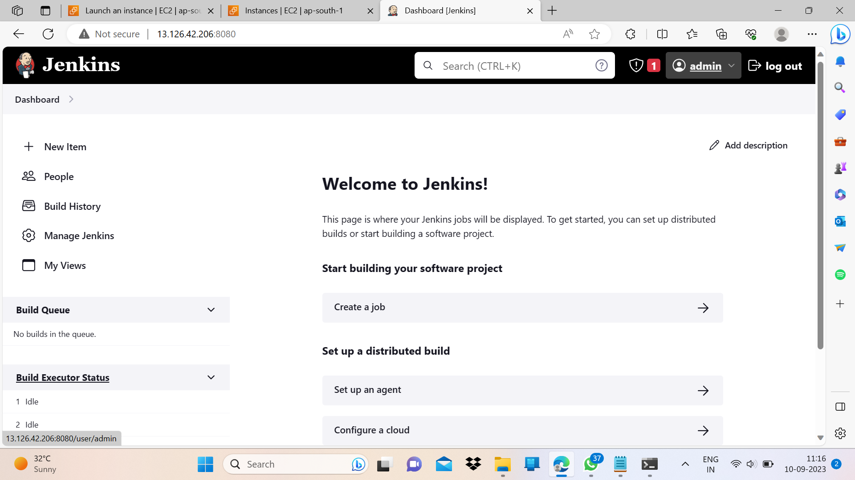
Go to admin -> Configure -> scroll down to set custom password.

Slide 22
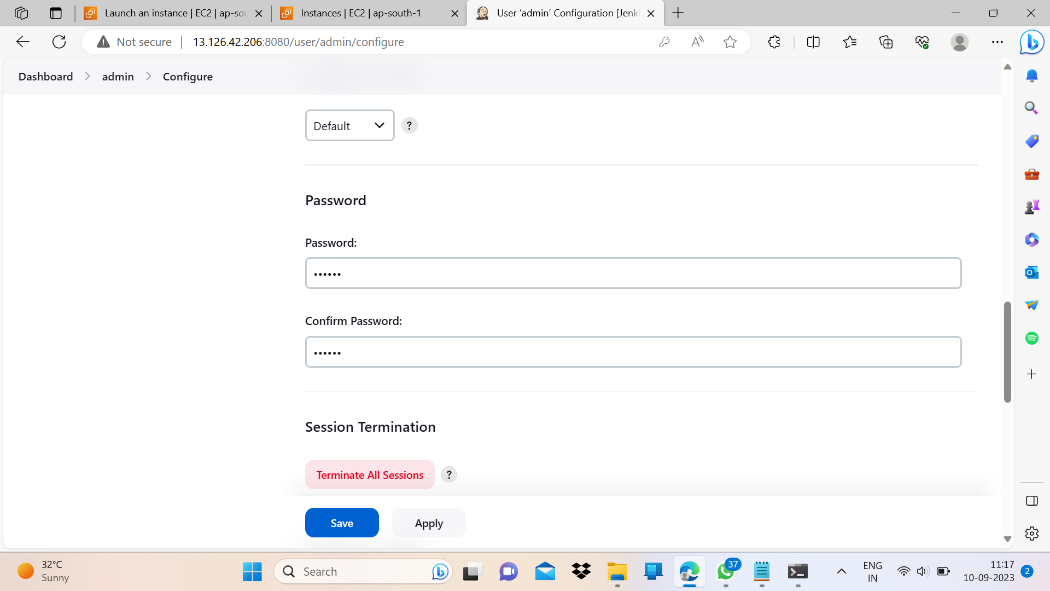
Type and confirm the new password and then apply and save it.

Slide 23
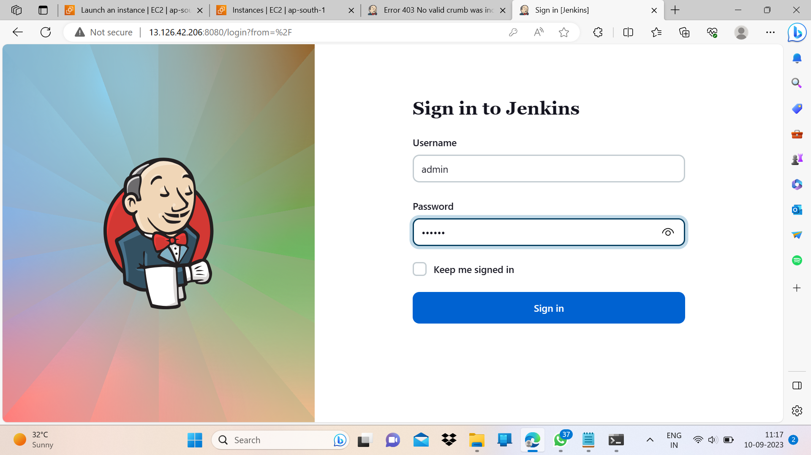
Log in again using your credentials.

Slide 24
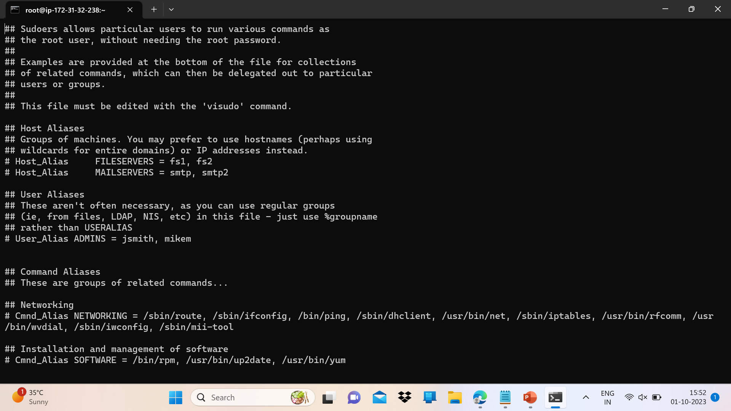
Open terminal and fire “sudo visudo” command. A file gets opened, scroll down to #Allow root to run any command anywhere.”

Slide 25
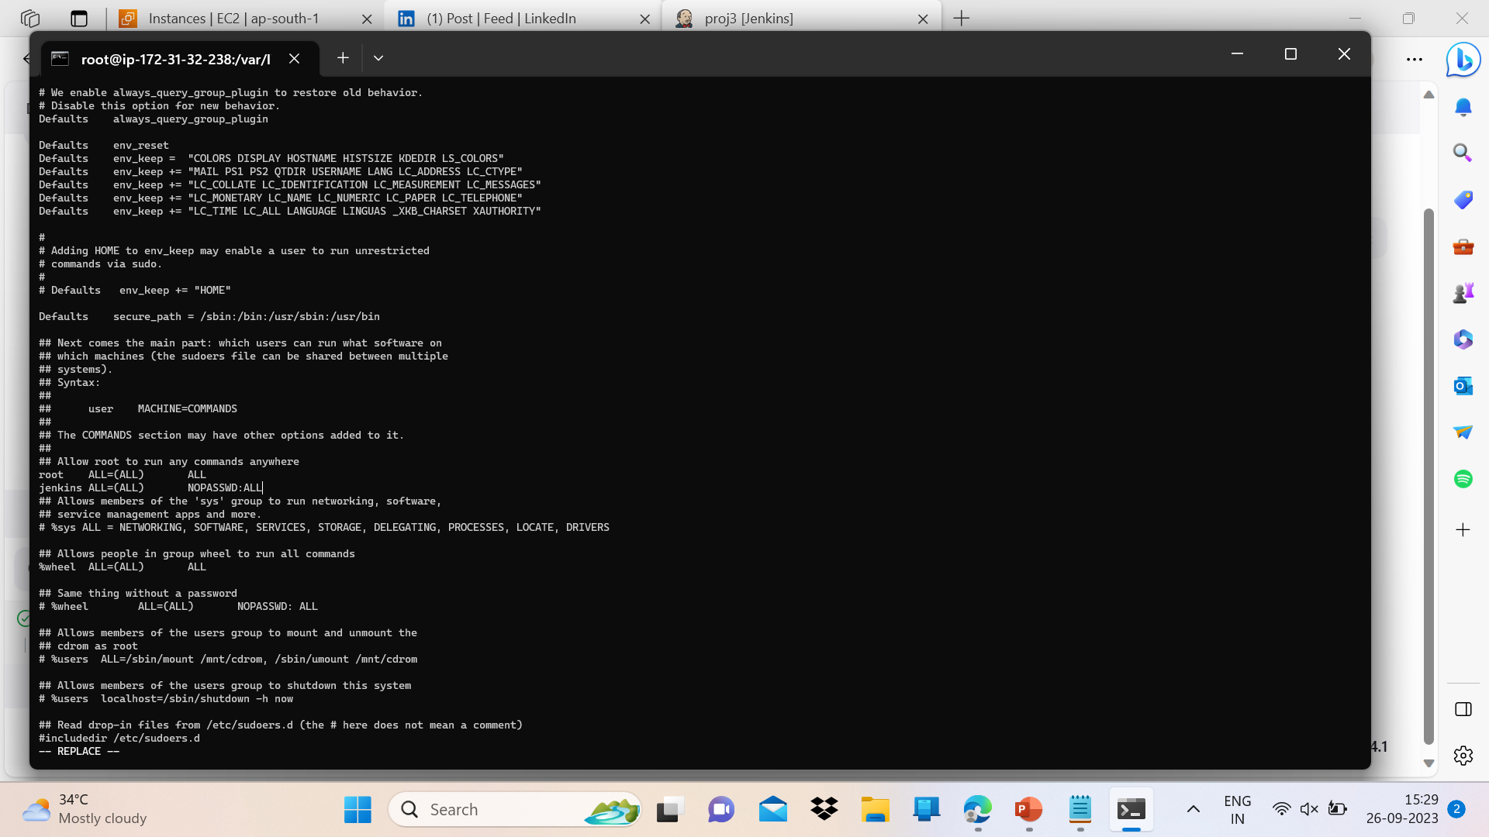
Add the following with proper alignment as shown:
jenkins ALL=(ALL) NOPASSWD:ALL

Slide 26
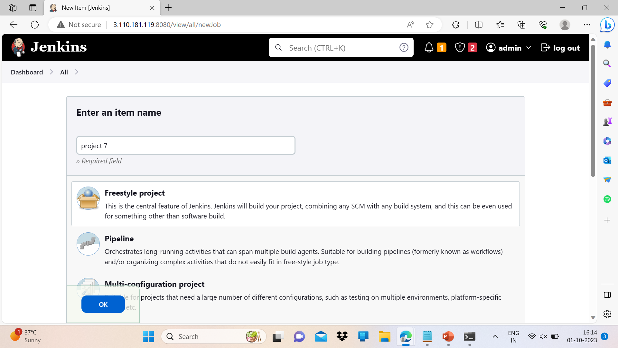
On Jenkins page click on : New item -> project name -> freestyle project -> ok

Slide 27
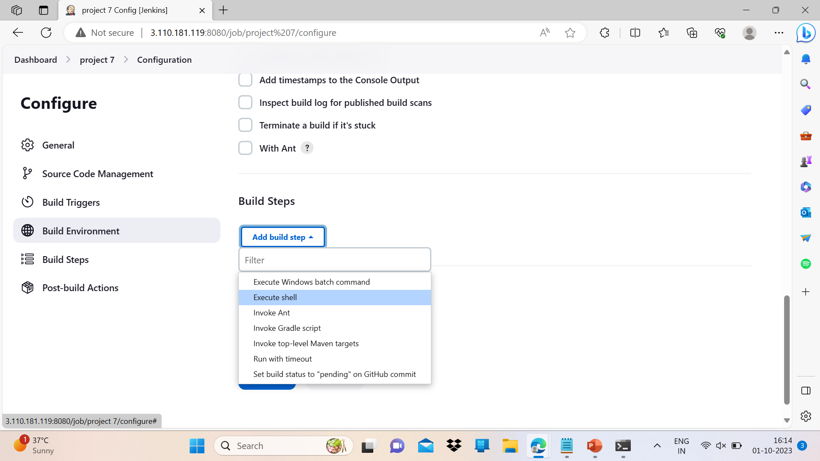
Scroll down to build steps -> add build steps -> execute shell.

Slide 28
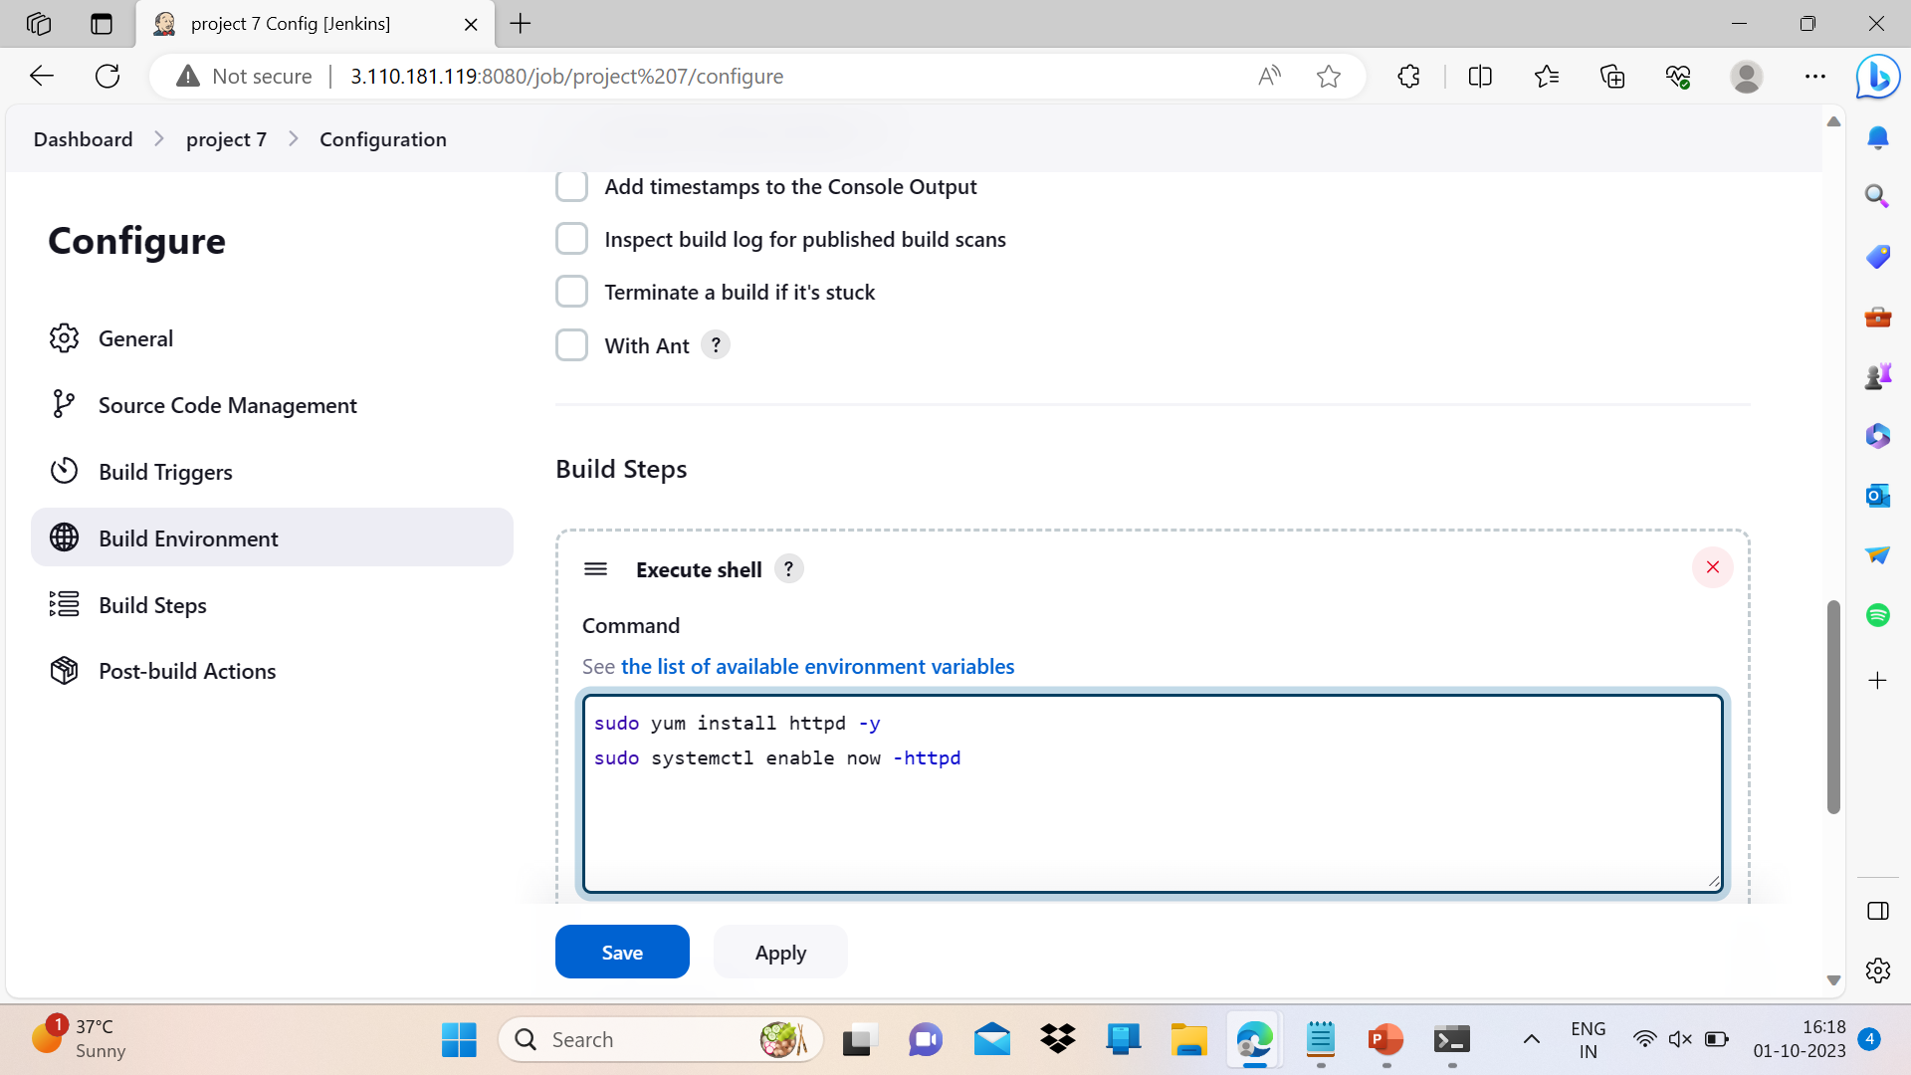
Type the following commands in execute shell box as shown then apply and save:
sudo yum install httpd –y
sudo systemctl enable –now httpd

Slide 29
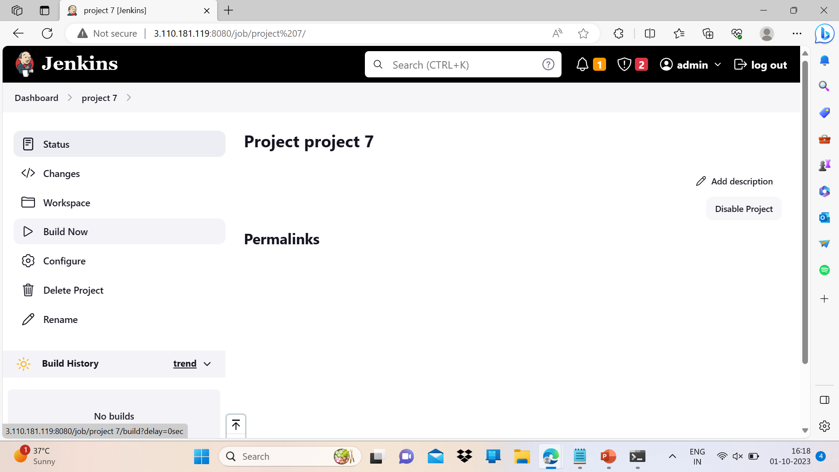
Click on build now.

Slide 30
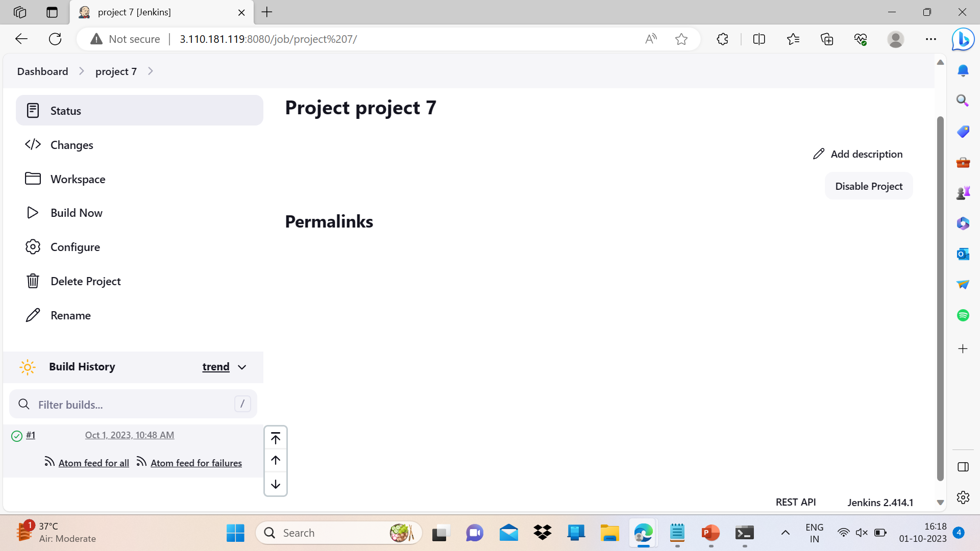
This green color shows that your build is successful.

Slide 31
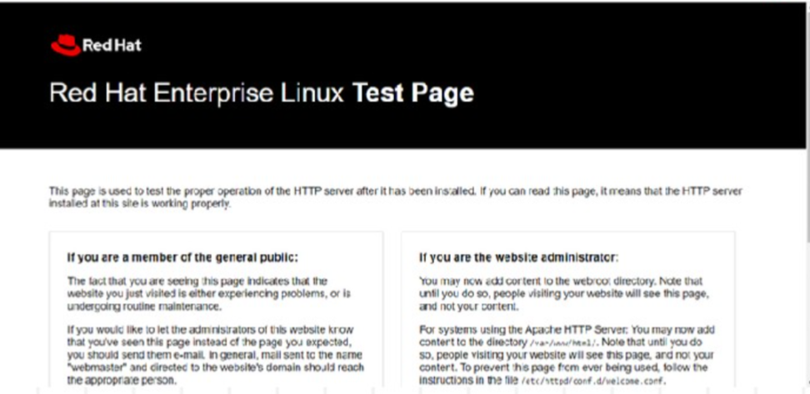
Paste the public IP on google to see the default httpd page.

Slide 32
Git Installation and working part
Launch a machine named “developer” and install git on it.
Now login to machine(using ssh) and execute the following set of commands:
sudo –I
yum install git –y
git --version
mkdir d1
cd d1/
vi index.html -> “write anything” -> save and exit.
vi bh.html -> “write anything” -> save and exit.
git init
git add *
git commit –m “write commit message”

Slide 33
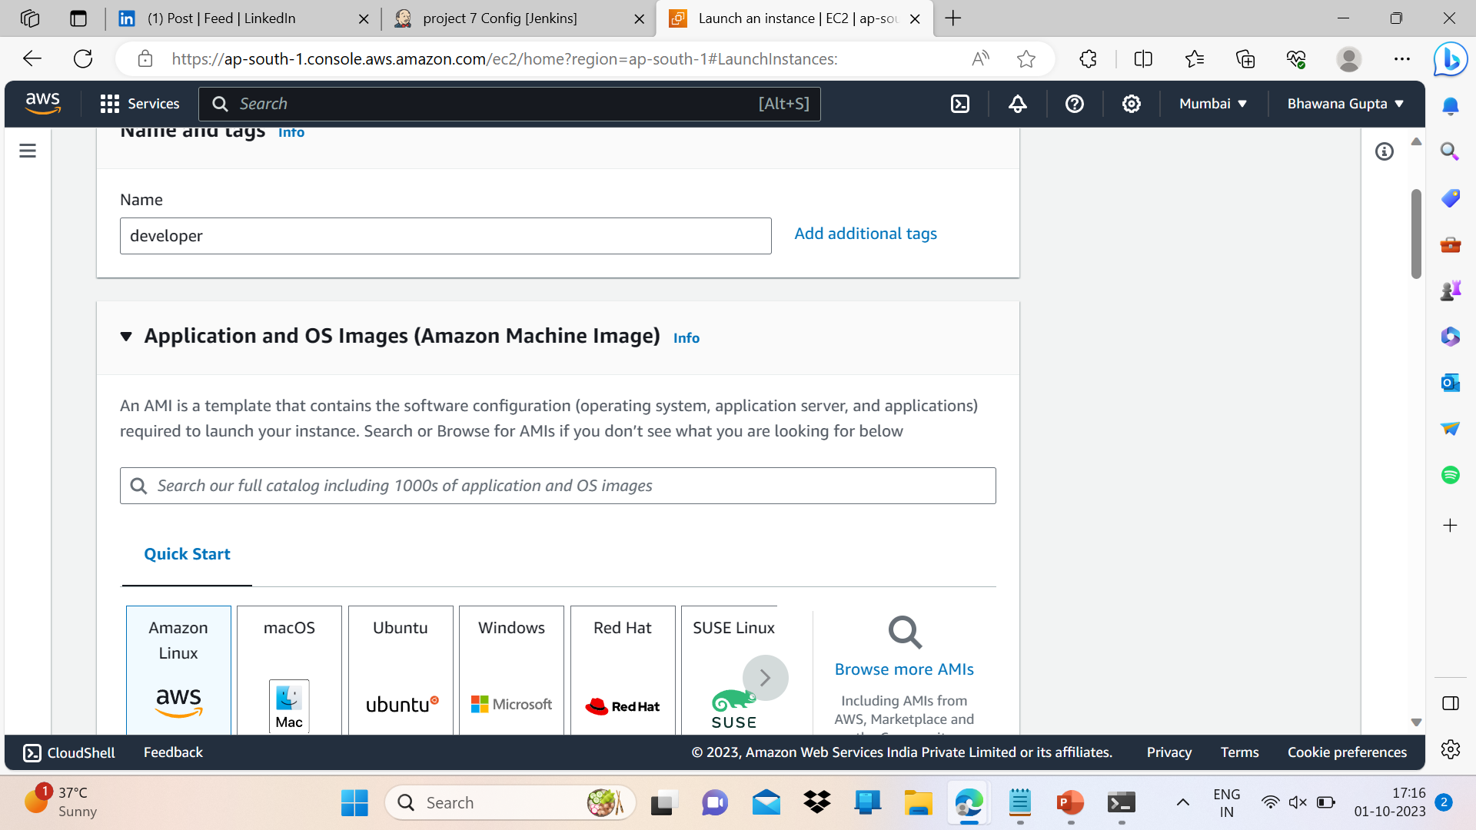
Following screenshots shows one by one execution of the above commands.

Slide 34
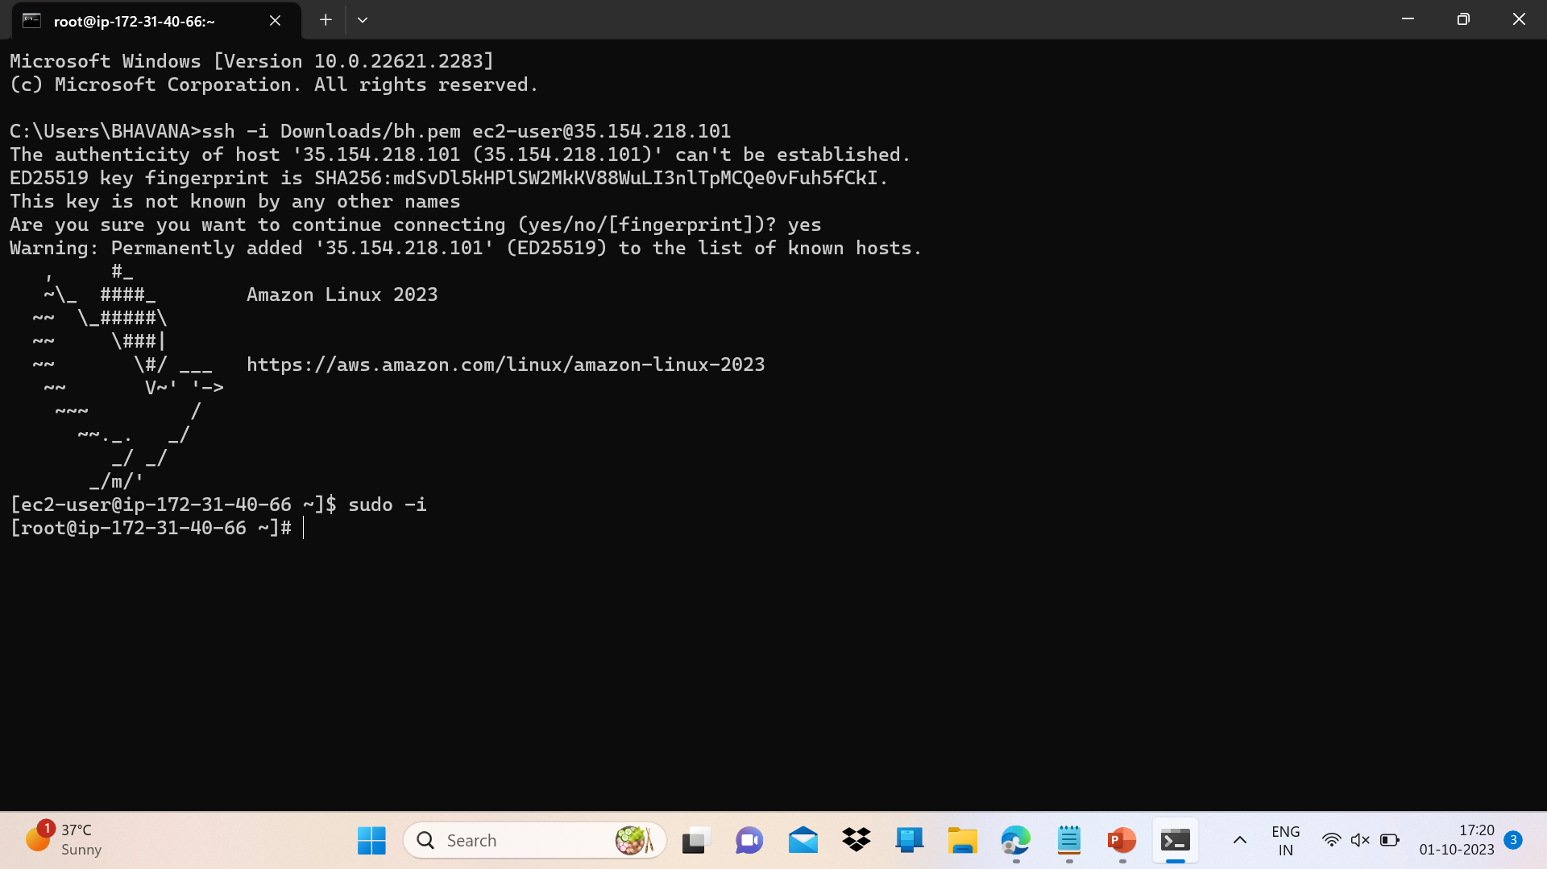

Slide 35
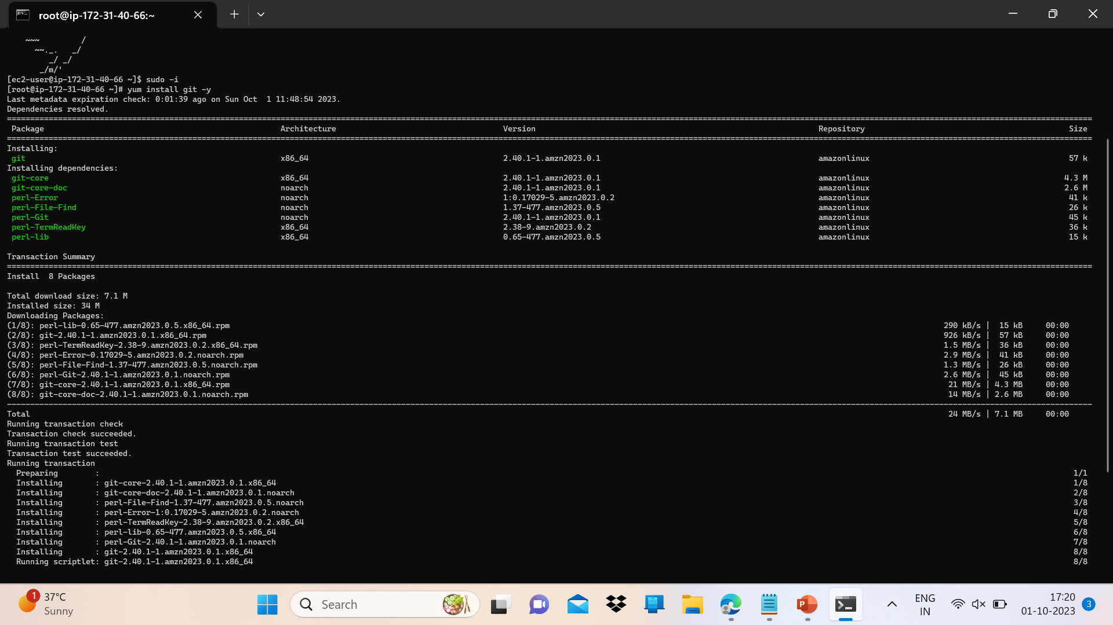

Slide 36
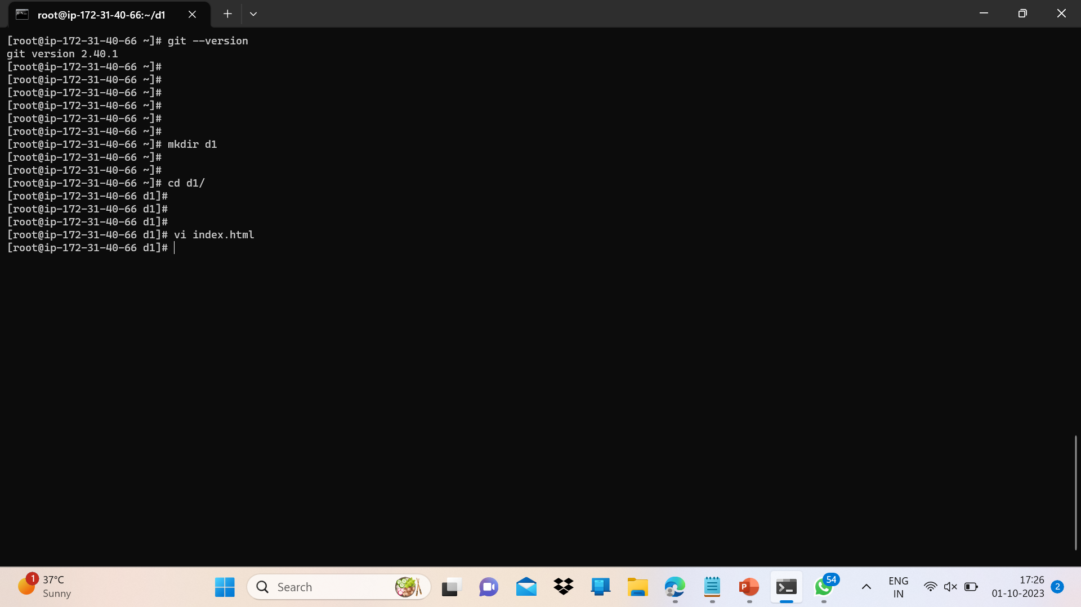

Slide 37
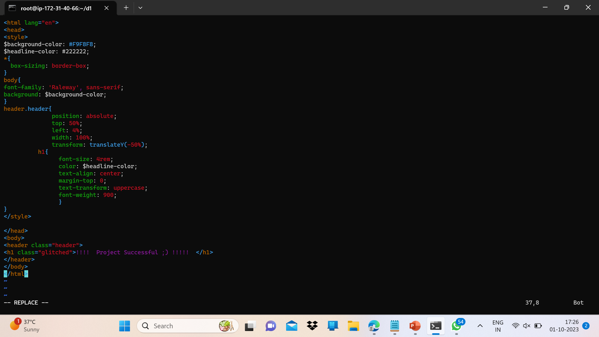
HTML code, one can write simple text also. Save and exit and do similarly for “bh.html”.

Slide 38
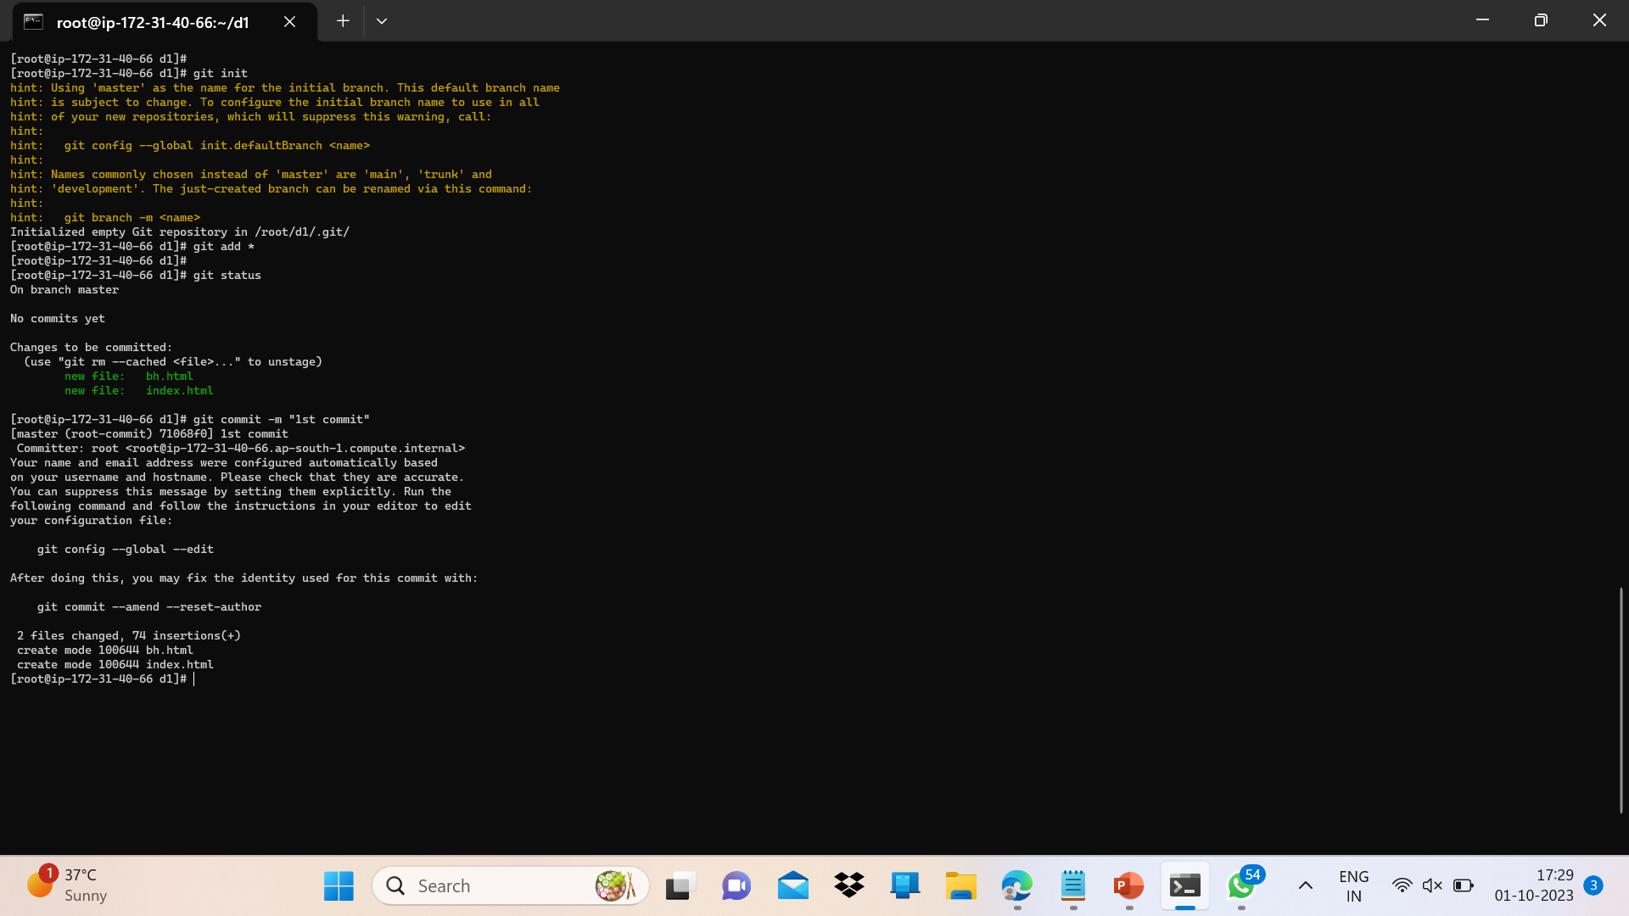

Slide 39
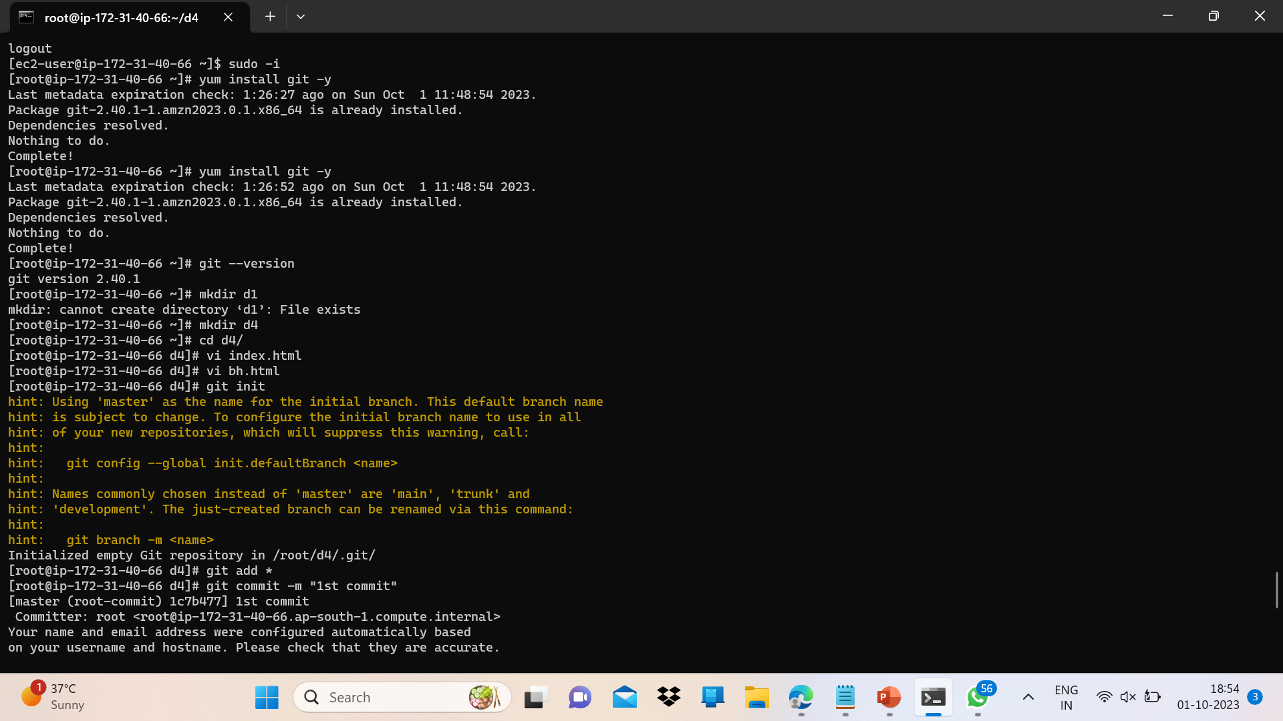

Slide 40
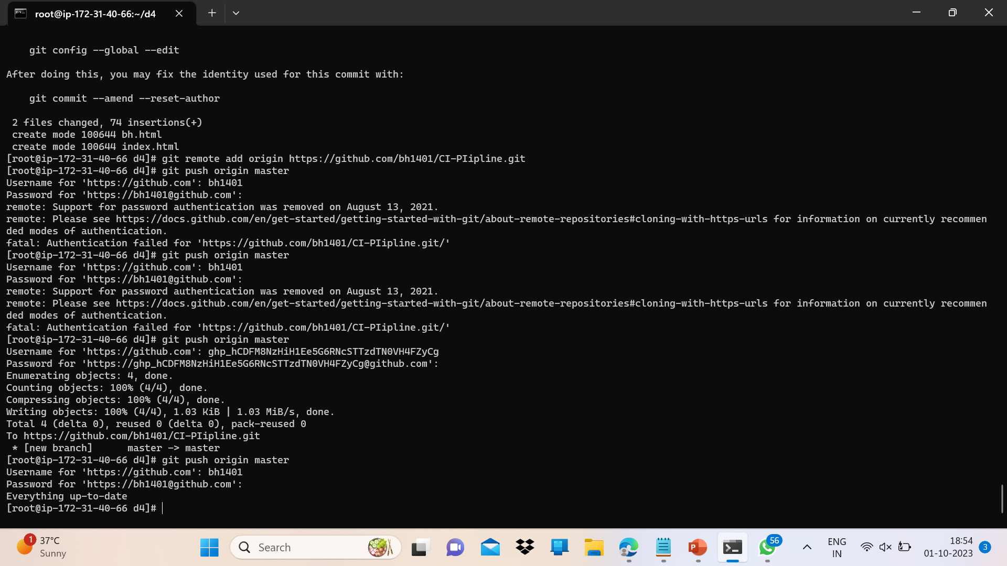

Slide 41
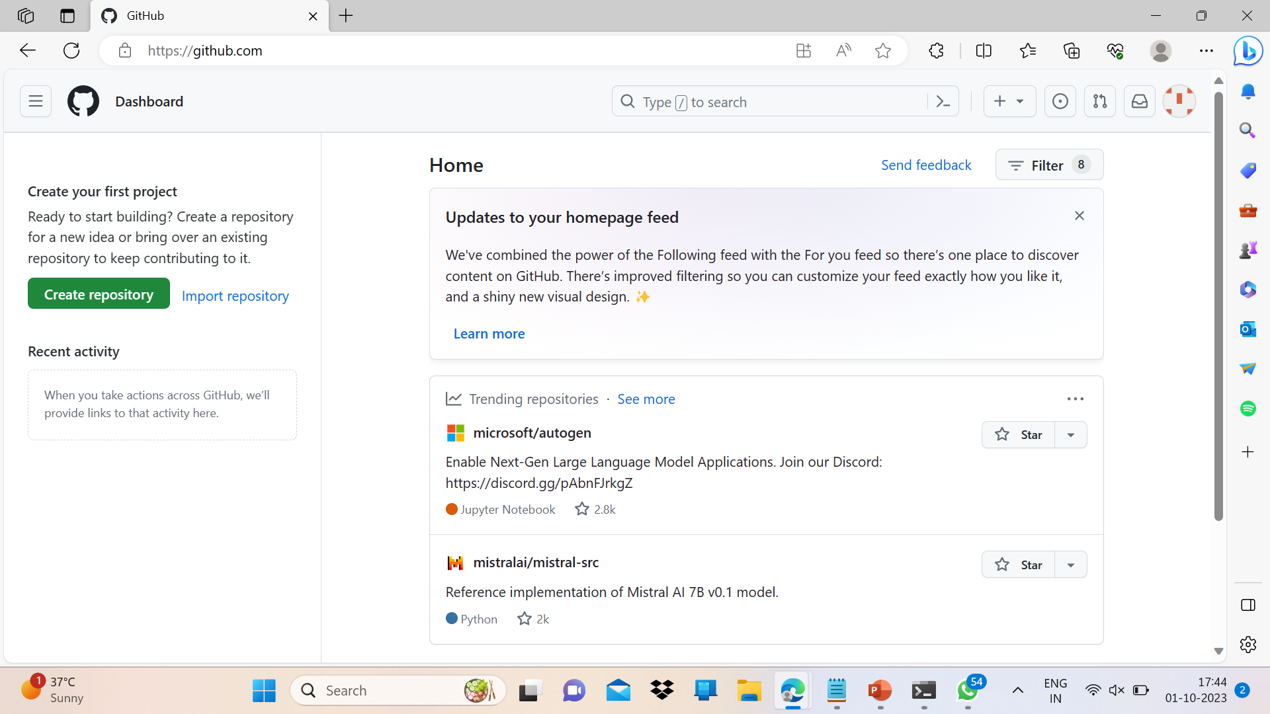
Open https://hithub.com? And login and do the following as shown:
Create a New repo -> Name it ->click on create repo.

Slide 42
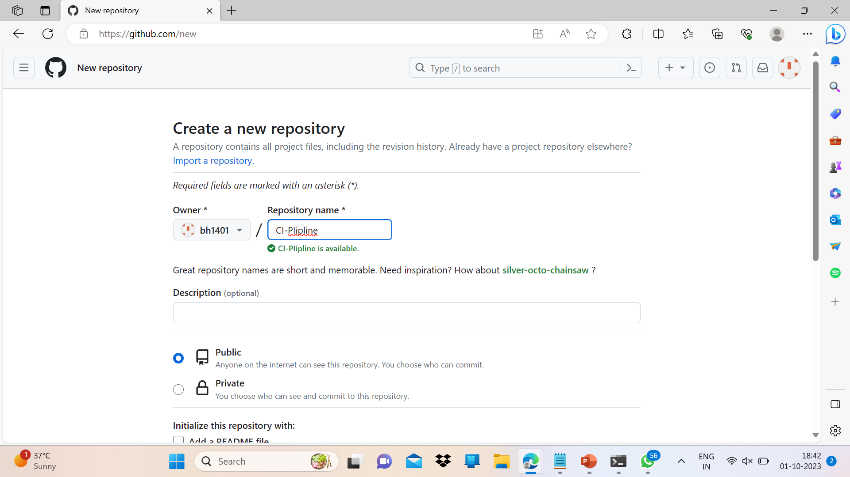

Slide 43
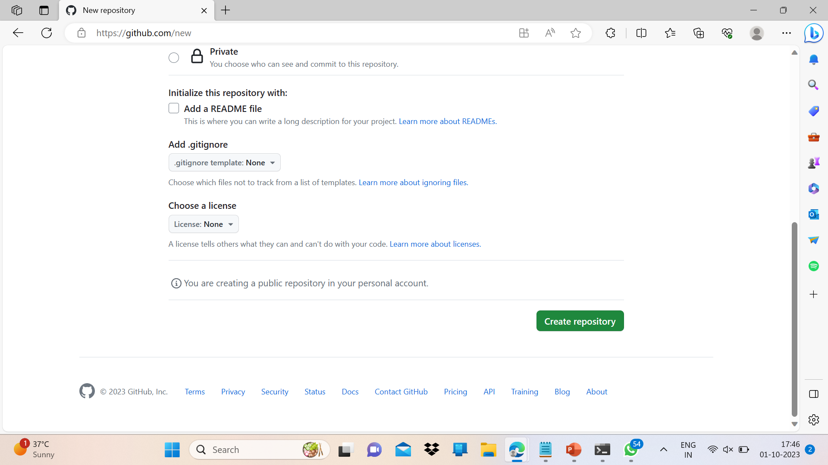

Slide 44
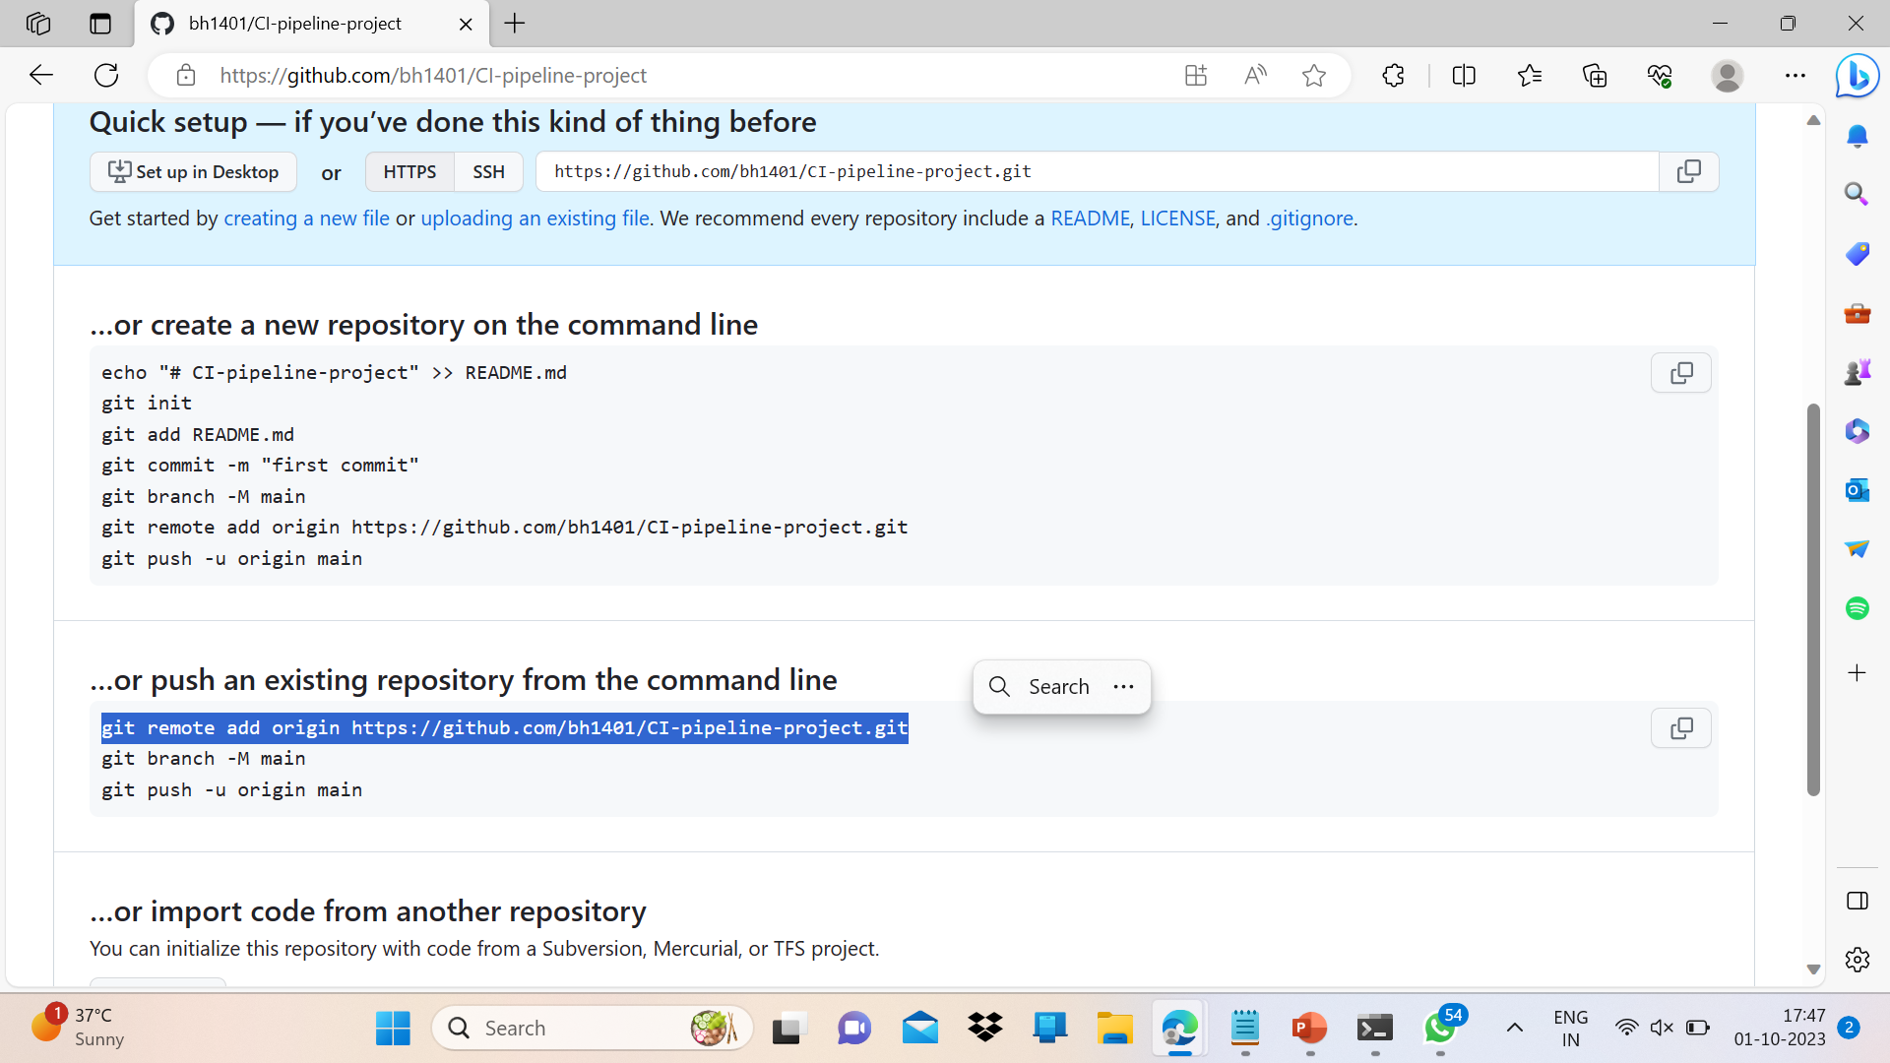

Slide 46
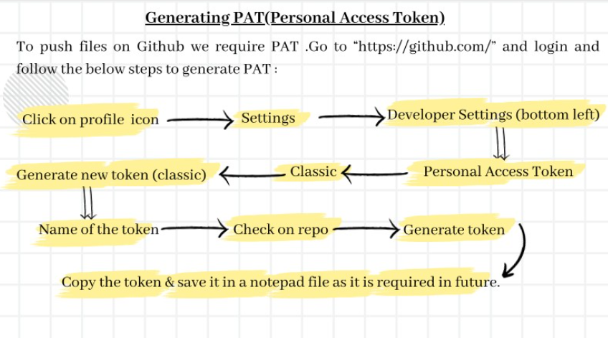

Slide 47
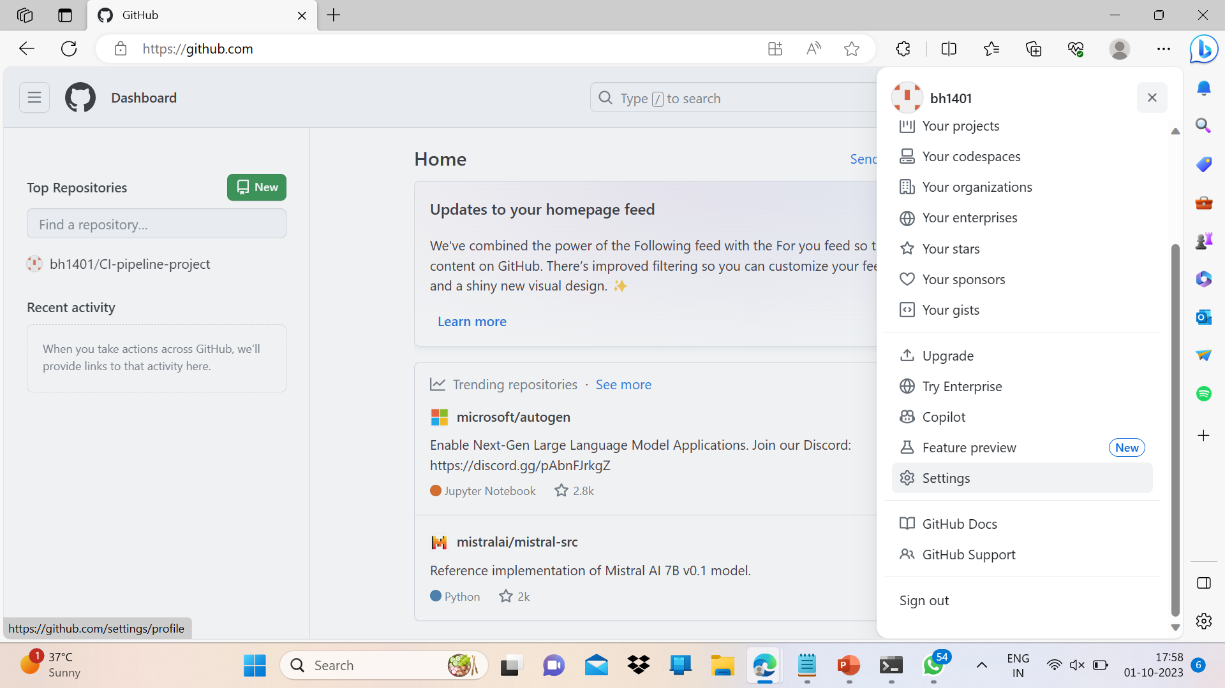

Slide 48
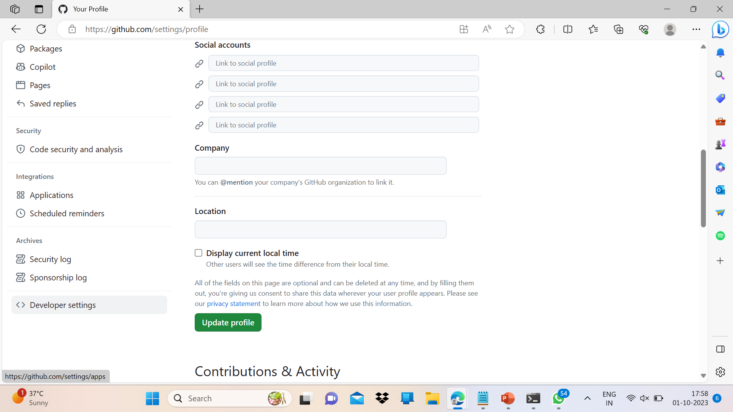

Slide 49
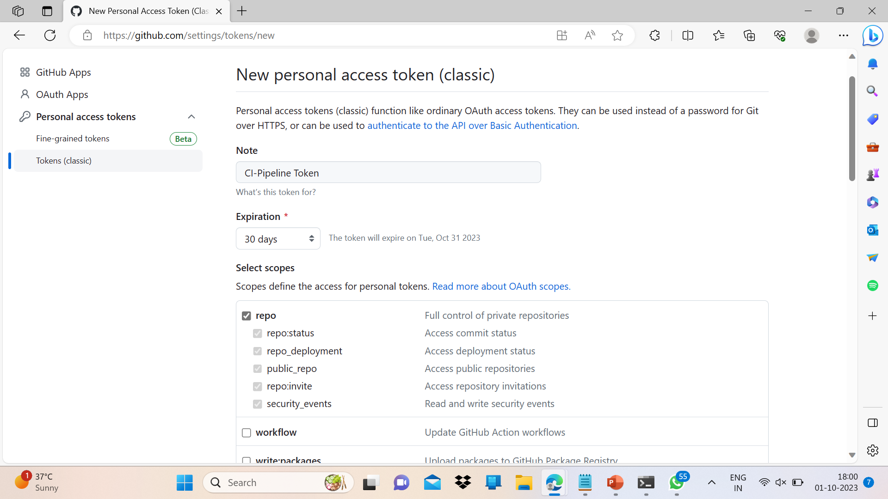

Slide 50
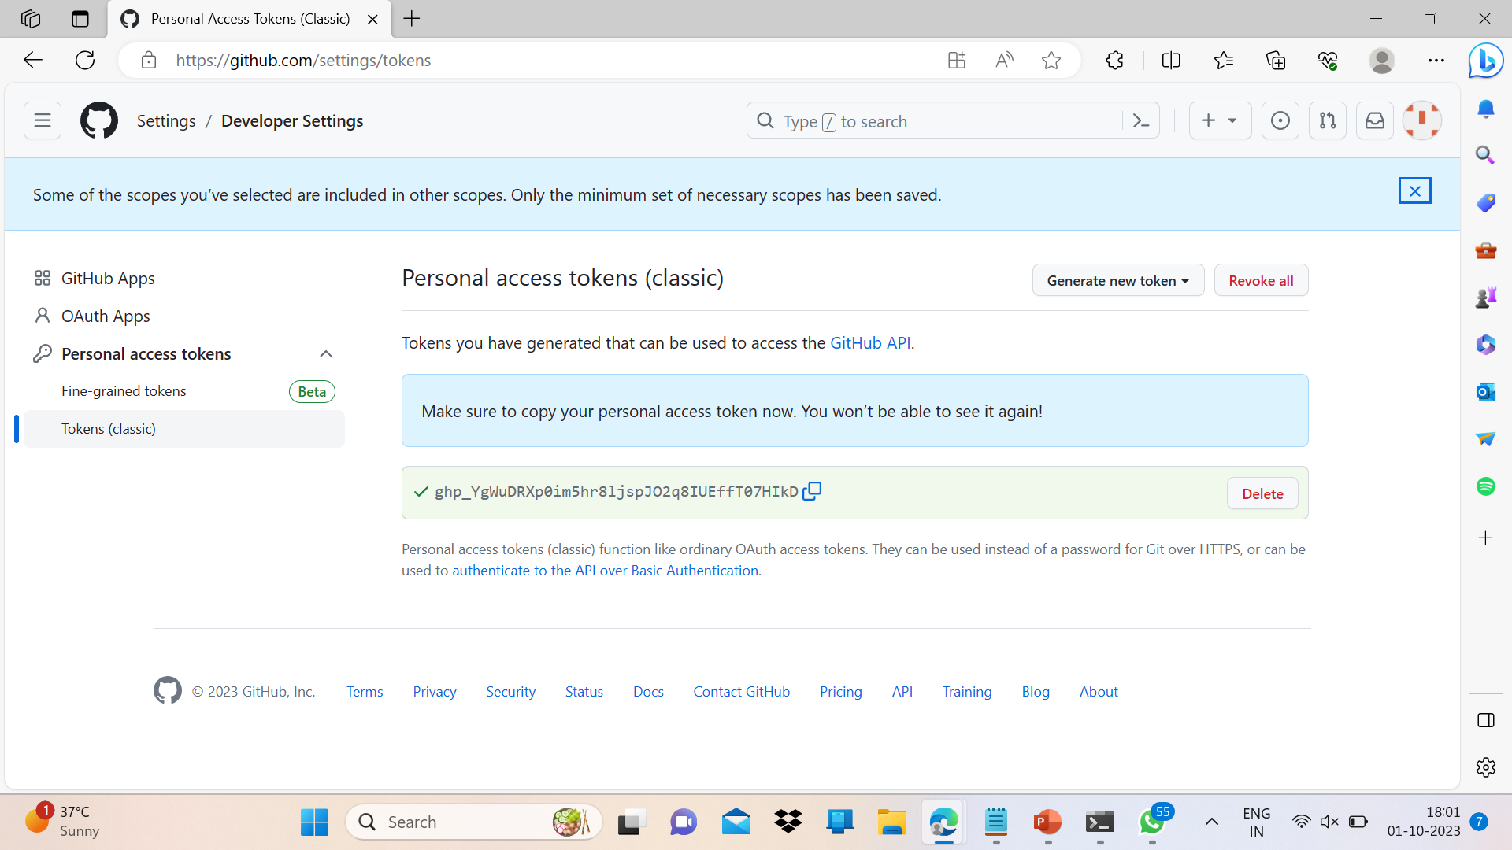

Slide 51
Now, since the PAT is generated we can ito push files on our project repository.
Come in developer machine and fire the following commands to push html files on Github.
Git push origin master
Enter username
Paste PAT
Below Screenshots shows the execution of the above steps:

Slide 53
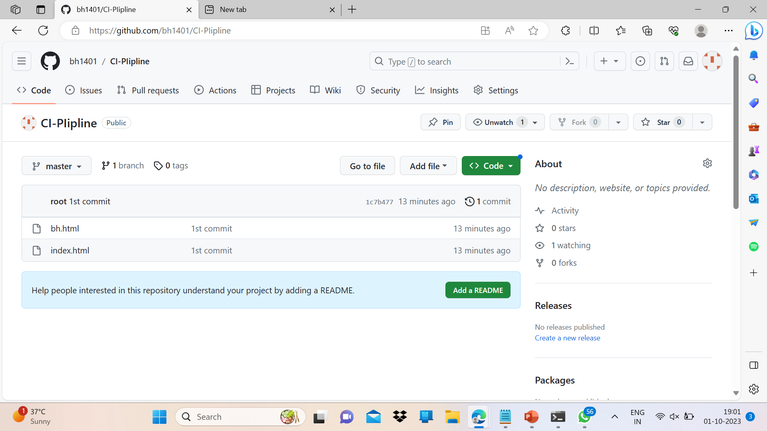
We can see that files have been added in the project repo and install github in Jenkins.

Slide 54
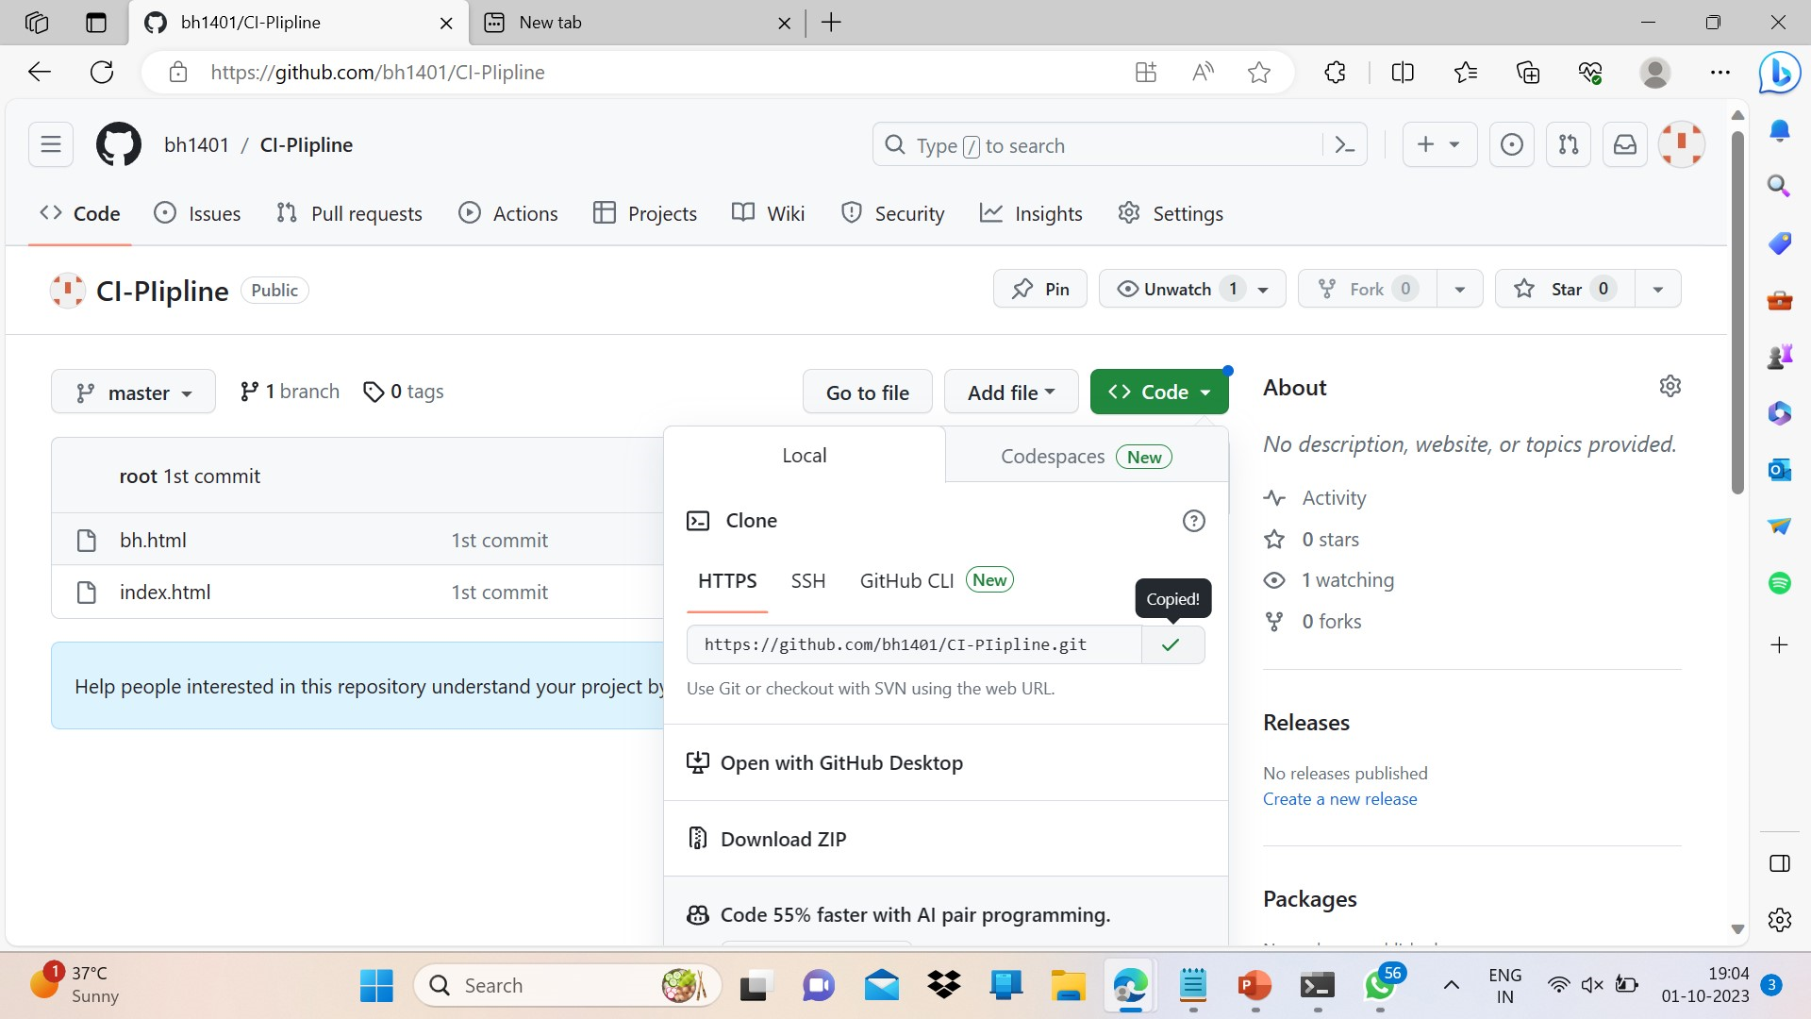

Slide 55
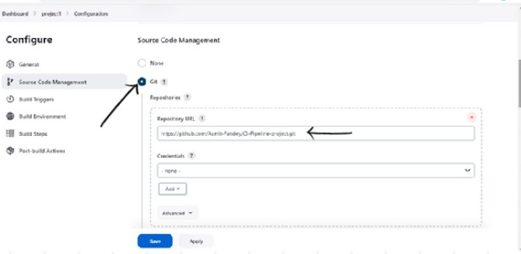
On Jenkins page go to -> project1 -> configure -> check git and paste the copied url in repo bar.

Slide 56
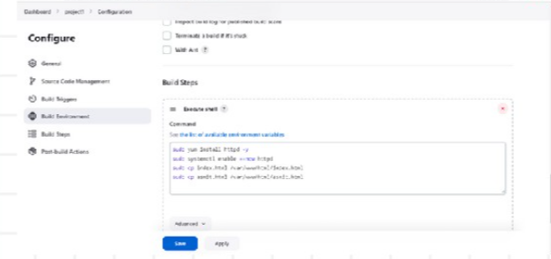
Add the following two commands in execute shell box, then Apply -> save -> build now.
Sudo cp index.html /var/www/tml/index.html
Sudo cp bh.html var/www/html/bh.html

Slide 57
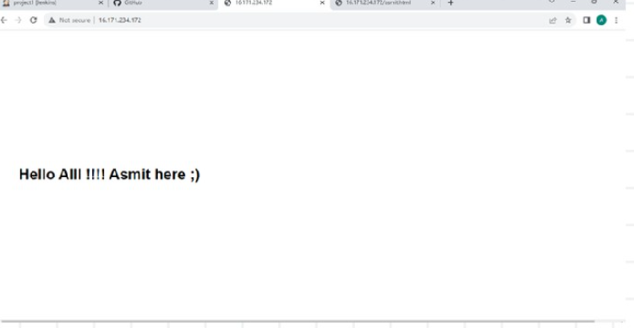

After build is successfill y completed, paste the public ip on browser to see the output.

Slide 58
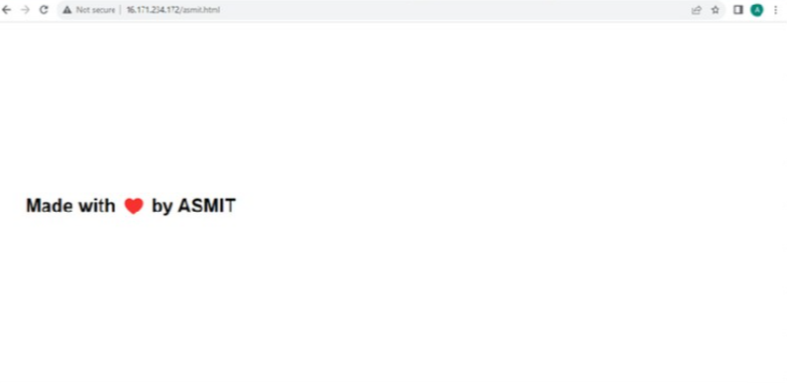

Paste “ip/bh.html” to see this on web.

Slide 59
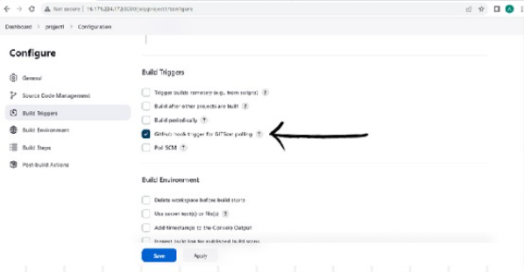
Setting up CI pipeline
Let’s finally set up the CI pipeline using github webhooks.
On Jenkins page go to:project1-> configure->
Check “Github hook trigger for GITScm polling” -> apply and save -> build now.

Slide 60
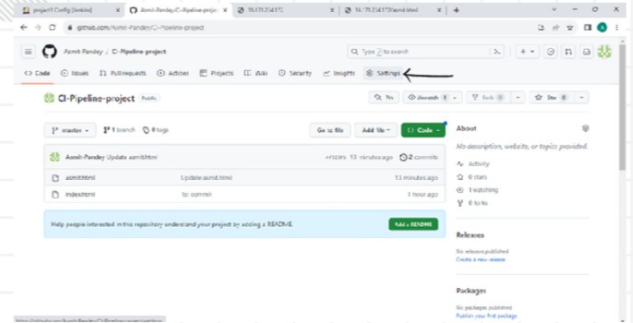
Now lets add webhook.
On github project repo: Click on settings -> webhooks -> add webhook

Slide 61
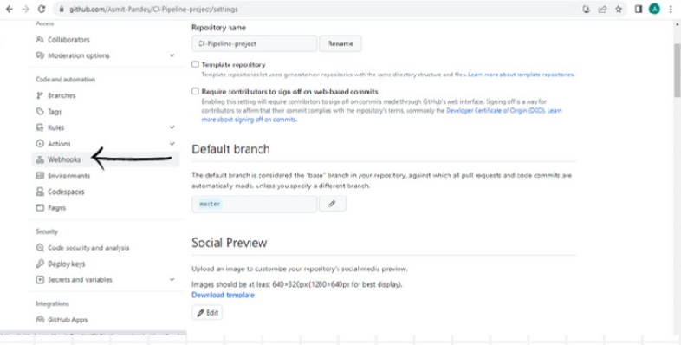

Slide 62

Paste the url of Jenkins in paylod URL and add”/github-webhook/”at the end -> click on add webhook.

Slide 63


Slide 64

Now come to the developer machine and do the changes in “index.html and “bh.html” to see if the changes are reflected automatically.

Slide 65

Modifying “bh,html”

Slide 66

Now fire the following commands to commit changes & push it to github repo:
git add *
git commit –m “Write Commit message”

Slide 67

git push origin master
Enter username
Paste PAT

Slide 68

Refresh the web pages on browser and you’ll be able to see the changes reflected automatically. Hence our CI pipeline is build and successfull

Slide 69






Slide 70
THANK YOU!!!!

